Slide 1
St. Louis Central Corridor West Building Permits
Monthly Report: September 2020

Slide 2
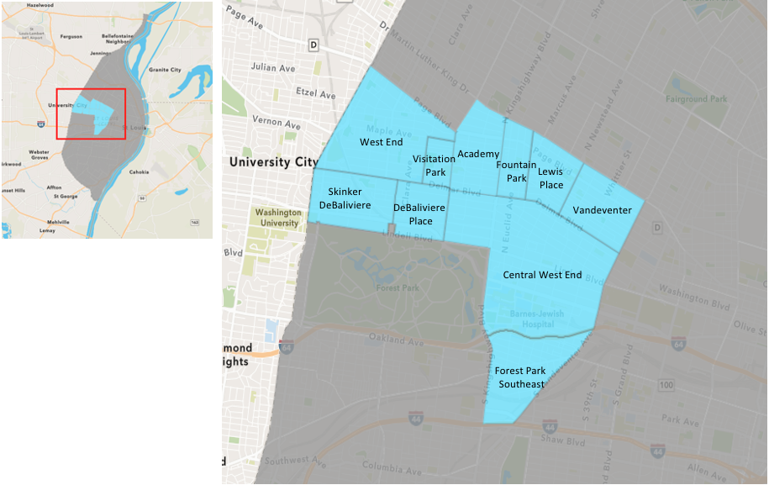
St. Louis Neighborhood Spatial Reference

Slide 3
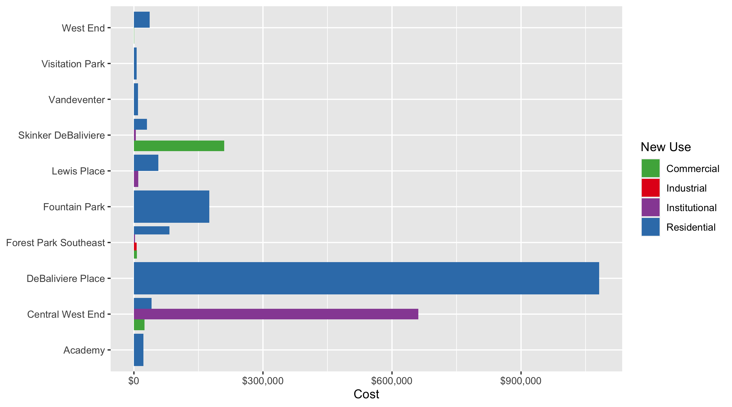
Neighborhood Summary: Average Building Permit Cost

Slide 4
Neighborhood Summary
September 2020 | September 2020 | September 2020 | September 2020
Neighborhood | Average Cost | # of Permits | Total Value of Permits
Academy | $21,868 | 4 | $87,470
Central West End | $212,487 | 39 | $8,286,999
DeBaliviere Place | $1,081,385 | 10 | $10,813,852
Forest Park Southeast | $55,545 | 17 | $944,260
Fountain Park | $175,000 | 1 | $175,000
Lewis Place | $44,875 | 4 | $179,500
Skinker DeBaliviere | $55,755 | 13 | $724,815
Vandeventer | $9,324 | 2 | $18,649
Visitation Park | $6,400 | 1 | $6,400
West End | $28,552 | 9 | $256,972
Last 6 Months | Last 6 Months | Last 6 Months | Last 6 Months
Neighborhood | Average Cost | # of Permits | Total Value of Permits
Academy | $27,711 | 25 | $692,770
Central West End | $418,675 | 225 | $94,201,836
DeBaliviere Place | $391,736 | 38 | $14,885,951
Forest Park Southeast | $54,178 | 74 | $4,009,205
Fountain Park | $83,071 | 7 | $581,500
Lewis Place | $60,689 | 13 | $788,960
Skinker DeBaliviere | $999,297 | 65 | $64,954,317
Vandeventer | $44,478 | 7 | $311,349
Visitation Park | $19,091 | 5 | $95,455
West End | $644,610 | 35 | $22,561,357

Slide 5
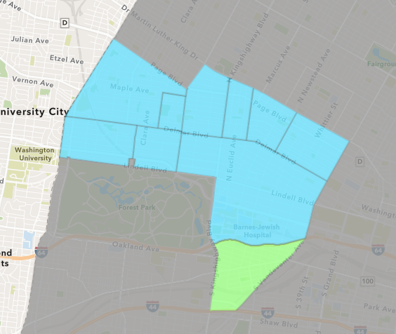
Forest Park Southeast
September 2020 Neighborhood Cost Breakdown
Mean: $55,545
Median: $7,600
Range: $1,000 - $543,188

Slide 6
Forest Park Southeast: Summary Notes
17 building permits in September 2020
-5.56% change compared to September 2019 (18 total building permits)
$55,545: Average building permit cost in September 2020
-86.00% change compared to September 2019 ($396,674)
96 total building permits in 2020
-29.41% change YTD compared to this time in 2019 (136 total building permits)
$56,899: YTD average building permit cost in 2020
-73.77% change YTD compared to this time in 2019 ($216,952)

Slide 7
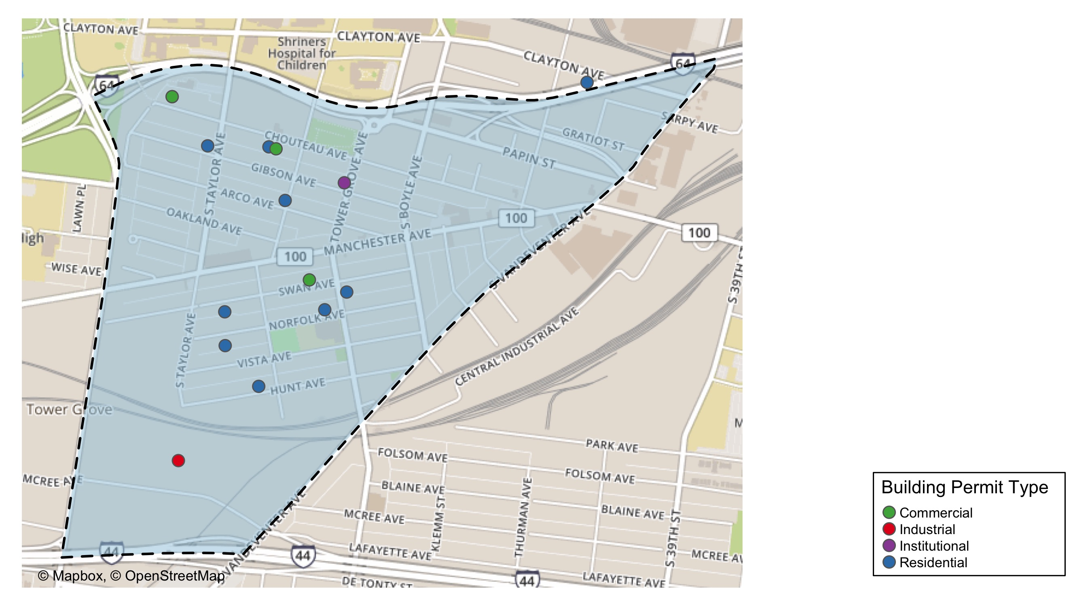
Forest Park Southeast

Slide 8
Neighborhood Summary
September 2020 | September 2020 | September 2020 | September 2020
Permit Use | Average Cost | # of Permits | Total Value of Permits
Commercial | $7,150 | 4 | $28,600
Industrial | $6,100 | 1 | $6,100
Institutional | $2,520 | 1 | $2,520
Residential | $82,458 | 11 | $907,040
Last 6 Months | Last 6 Months | Last 6 Months | Last 6 Months
Permit Use | Average Cost | # of Permits | Total Value of Permits
Commercial | $55,940 | 15 | $839,100
Industrial | $267,033 | 3 | $801,100
Institutional | $4,737 | 7 | $33,160
Residential | $47,670 | 49 | $2,335,845

Slide 9
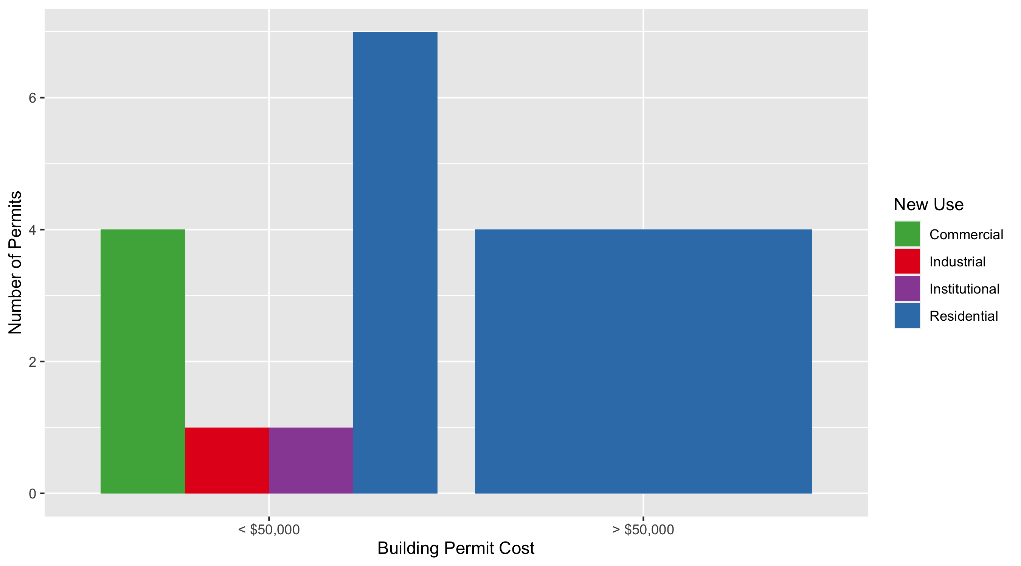
Forest Park Southeast Permit Cost Breakdown

Slide 10
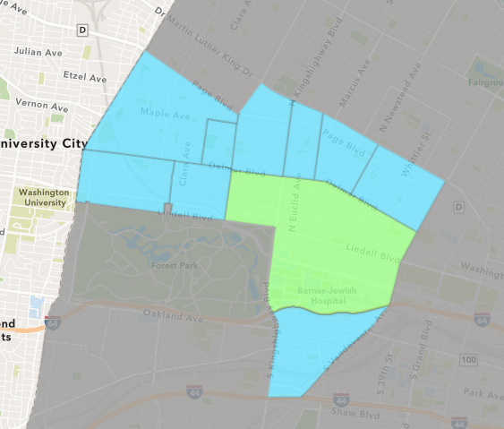
Central West End
September 2020 Neighborhood Cost Breakdown
Mean: $212,487
Median: $15,000
Range: $941 - $6,300,000

Slide 11
Central West End: Summary Notes
39 building permits in September 2020
-25.00% change compared to September 2019 (52 total building permits)
$212,487: Average building permit cost in September 2020
172.16% change compared to September 2019 ($78,075)
337 total building permits in 2020
-6.91% change YTD compared to this time in 2019 (362 total building permits)
$395,525: YTD average building permit cost in 2020
75.88% change YTD compared to this time in 2019 ($224,882)

Slide 12
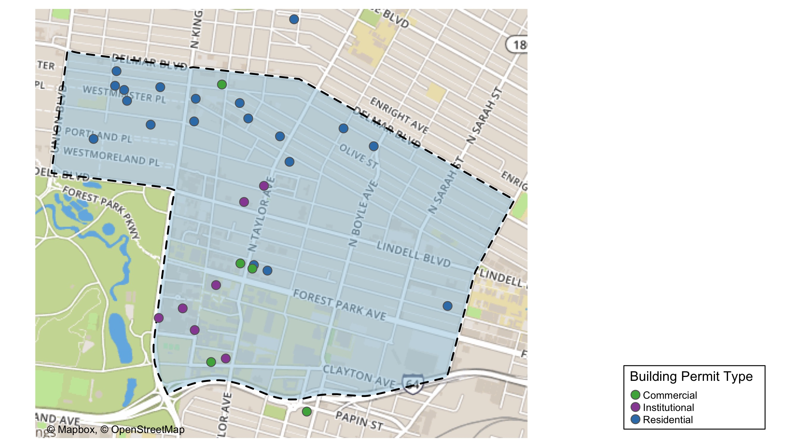
Central West End

Slide 13
Central West End
September 2020 | September 2020 | September 2020 | September 2020
Permit Use | Average Cost | # of Permits | Total Value of Permits
Commercial | $24,411 | 8 | $195,290
Industrial | $0 | 0 | $0
Institutional | $661,385 | 11 | $7,275,237
Residential | $40,824 | 20 | $816,472
Last 6 Months | Last 6 Months | Last 6 Months | Last 6 Months
Permit Use | Average Cost | # of Permits | Total Value of Permits
Commercial | $70,930 | 36 | $2,553,465
Industrial | $20,000 | 1 | $20,000
Institutional | $623,766 | 71 | $44,287,412
Residential | $404,624 | 117 | $47,340,959

Slide 14
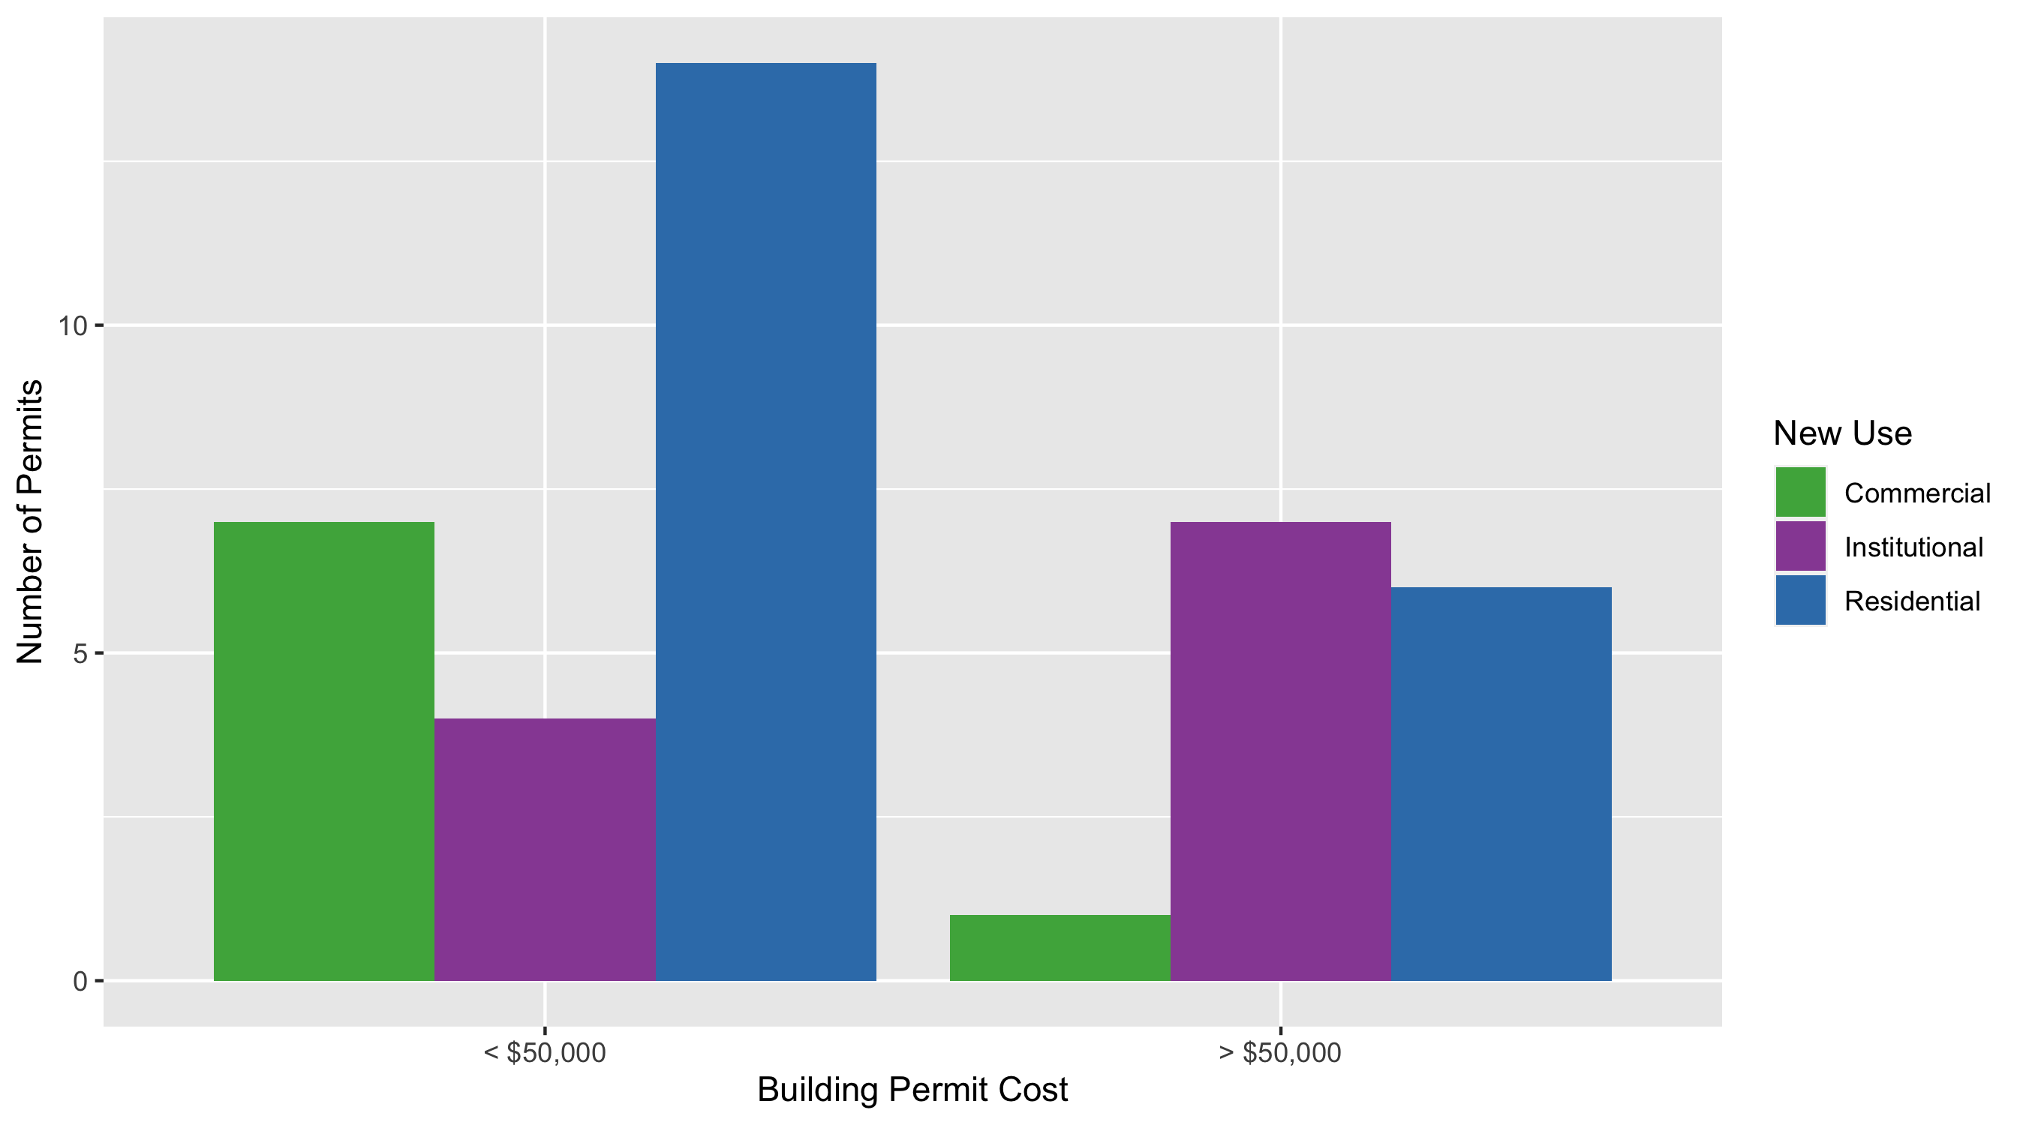
Cental West End Permit Cost Breakdown

Slide 15
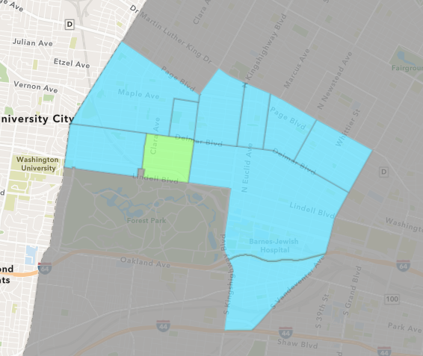
DeBaliviere Place
September 2020 Neighborhood Cost Breakdown
Mean: $1,081,385
Median: $135,000
Range: $100 - $7,150,000

Slide 16
DeBaliviere Place: Summary Notes
10 building permits in September 2020
150.00% change compared to September 2019 (4 total building permits)
$1,081,385: Average building permit cost in September 2020
834.61% change compared to September 2019 ($115,704)
48 total building permits in 2020
17.07% change YTD compared to this time in 2019 (41 total building permits)
$690,699: YTD average building permit cost in 2020
1172.46% change YTD compared to this time in 2019 ($54,281)

Slide 17
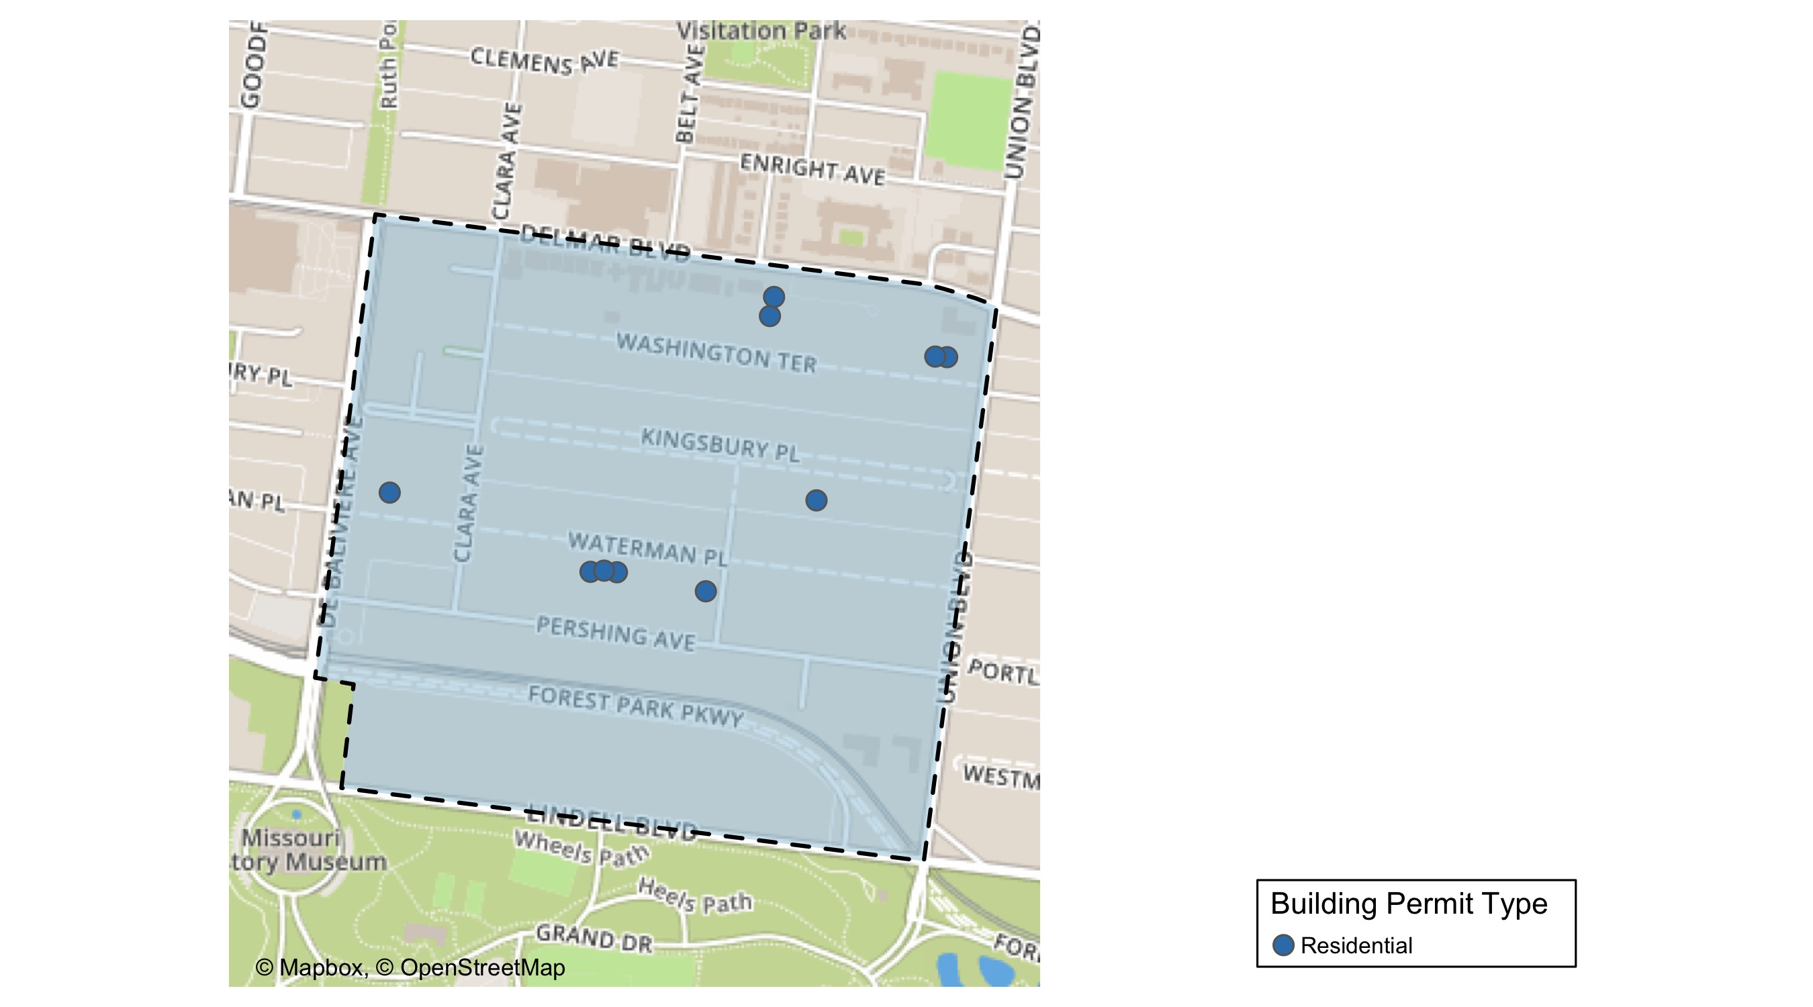
DeBaliviere Place

Slide 18
DeBaliviere Place
September 2020 | September 2020 | September 2020 | September 2020
Permit Use | Average Cost | # of Permits | Total Value of Permits
Commercial | $0 | 0 | $0
Industrial | $0 | 0 | $0
Institutional | $0 | 0 | $0
Residential | $1,081,385 | 10 | $10,813,852
Last 6 Months | Last 6 Months | Last 6 Months | Last 6 Months
Permit Use | Average Cost | # of Permits | Total Value of Permits
Commercial | $12,890 | 2 | $25,780
Industrial | $0 | 0 | $0
Institutional | $400 | 1 | $400
Residential | $424,565 | 35 | $14,859,771

Slide 19
DeBaliviere Place Individual Permit Breakdown
Owner | New Use | Cost | Address
TRAYMOOR 3 CONDOMINIUM | Residential | $118,284 | 5646 WATERMAN BLVD
REAL ESTATE INVESTOR WHOLESALE LLC | Residential | $3,000,000 | 5612-5624 WATERMAN BLVD
WATERMAN-PERSHING CONDO PLAT 1 | Residential | $4,568 | 5548 WATERMAN BLVD
GREGORY, PETER | Residential | $100 | 22 KINGSBURY PL
HUDSON KILAMANJARO V LLC | Residential | $7,150,000 | 5655 PERSHING AV
JEK SEP IRA FUND LLC | Residential | $135,000 | 5420 DELMAR PLACE CT
JEK SEP IRA FUND LLC | Residential | $135,000 | 5422 DELMAR PLACE CT
JEK SEP IRA FUND LLC | Residential | $135,000 | 5424 DELMAR PLACE CT
JEK SEP IRA FUND LLC | Residential | $135,000 | 5426 DELMAR PLACE CT
ANDERSON, FRED & JILL | Residential | $900 | 5679 WATERMAN BLVD

Slide 20
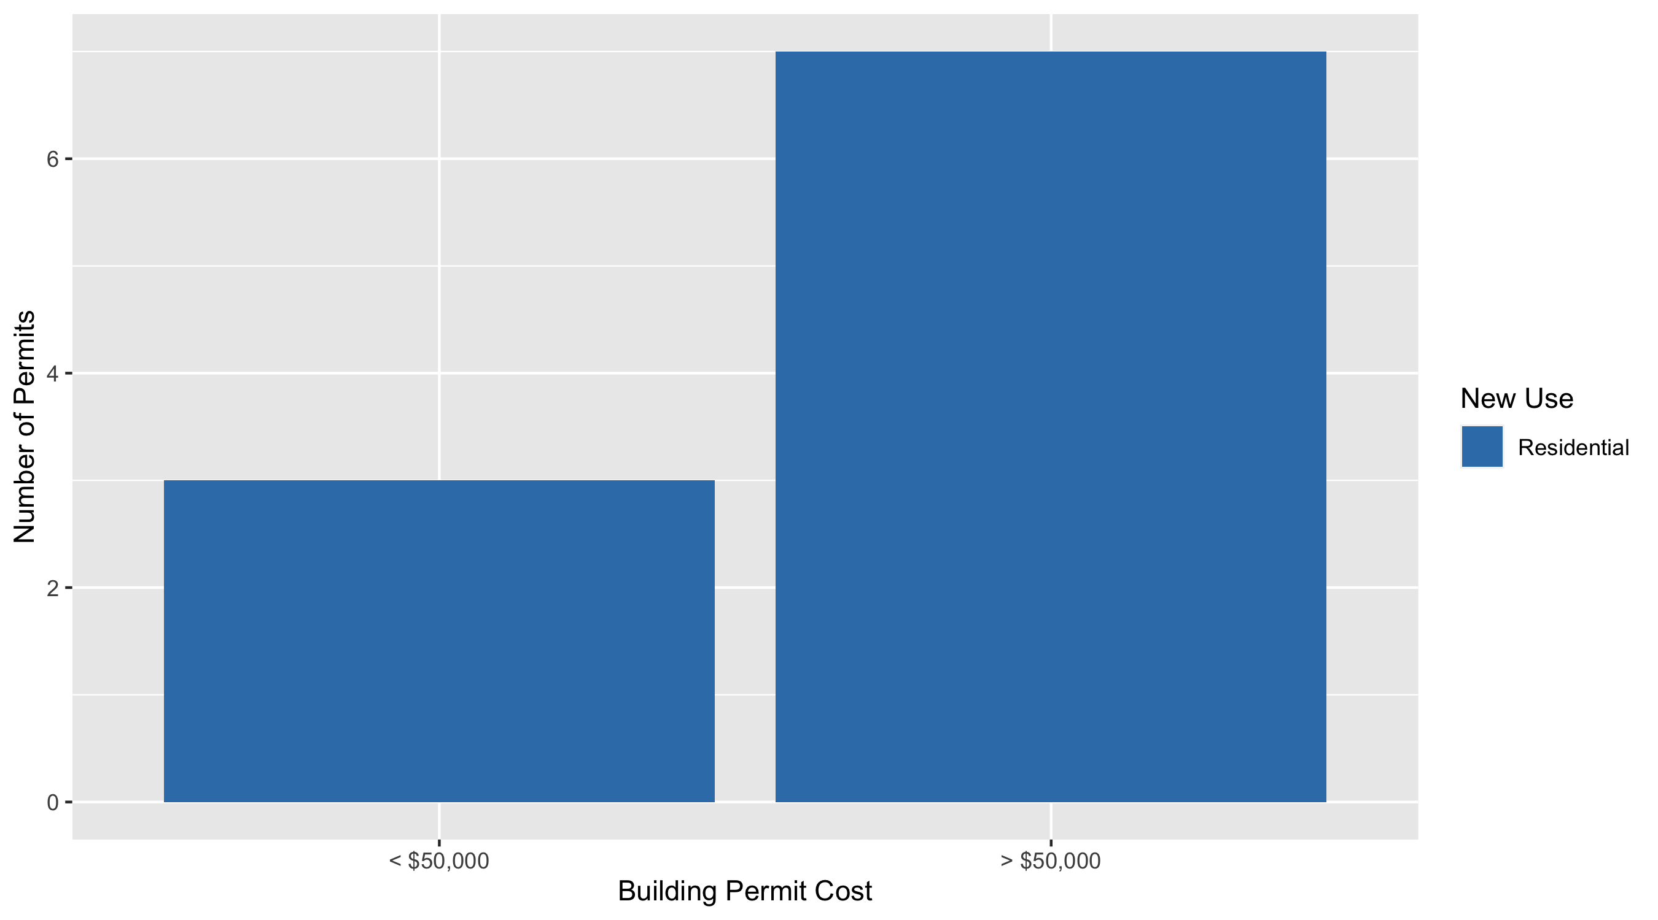
DeBaliviere Place Permit Cost Breakdown

Slide 21
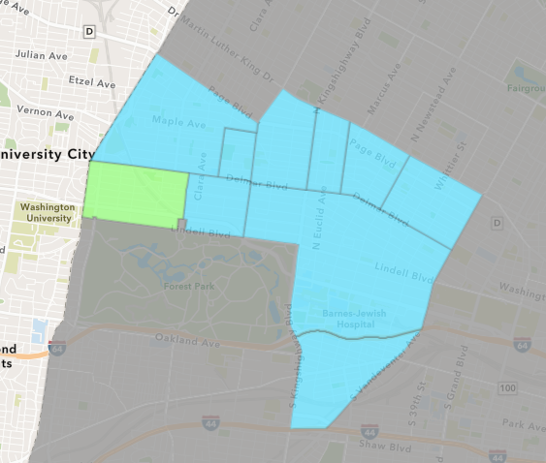
Skinker DeBaliviere
September 2020 Neighborhood Cost Breakdown
Mean: $55,755
Median: $6,500
Range: $3,000 - $400,000

Slide 22
Skinker DeBaliviere: Summary Notes
13 building permits in September 2020
333.33% change compared to September 2019 (3 total building permits)
$55,755: Average building permit cost in September 2020
27.00% change compared to September 2019 ($43,901)
100 total building permits in 2020
96.08% change YTD compared to this time in 2019 (51 total building permits)
$655,661: YTD average building permit cost in 2020
2872.22% change YTD compared to this time in 2019 ($22,060)

Slide 23
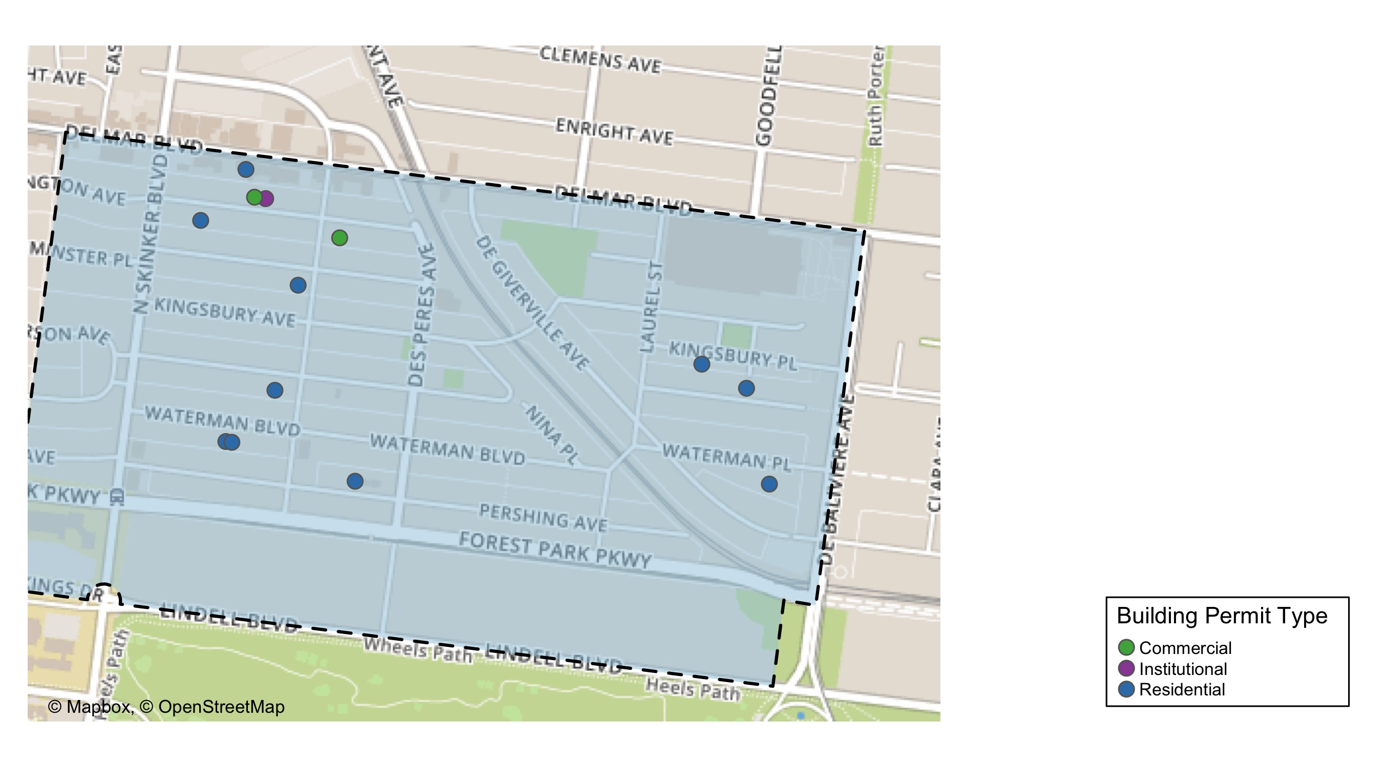
Skinker DeBaliviere

Slide 24
Skinker DeBaliviere
September 2020 | September 2020 | September 2020 | September 2020
Permit Use | Average Cost | # of Permits | Total Value of Permits
Commercial | $210,000 | 2 | $420,000
Industrial | $0 | 0 | $0
Institutional | $4,500 | 1 | $4,500
Residential | $30,032 | 10 | $300,315
Last 6 Months | Last 6 Months | Last 6 Months | Last 6 Months
Permit Use | Average Cost | # of Permits | Total Value of Permits
Commercial | $5,190,263 | 11 | $57,092,898
Industrial | $0 | 0 | $0
Institutional | $828,667 | 3 | $2,486,000
Residential | $105,400 | 51 | $5,375,419

Slide 25
Skinker DeBaliviere Individual Permit Breakdown
Owner | New Use | Cost | Address
WASHINGTON UNIVERSITY | Residential | $4,815 | 340 ROSEDALE AV
BIG BRICK BUILDINGS ML LLC | Residential | $5,000 | 6132 PERSHING AV
BIG BRICK BUILDINGS ML LLC | Residential | $5,000 | 6134-36 PERSHING AV
DUNN, JENNIFER & SYTSE PIERSMA | Residential | $6,500 | 5793 WATERMAN BLVD
HOLLMANN, PAUL D & PASCALE | Residential | $8,000 | 6164 WESTMINSTER PL
ENGEN, ABRAM VAN & KRISTIN VAN | Residential | $12,000 | 5893 NINA PL
GRITZ, LIGAYA | Residential | $3,000 | 6168 MCPHERSON AV
HAMSTERLAND LLC | Institutional | $4,500 | 6176-78 DELMAR BLVD
GORMAN, MARK B | Residential | $200,000 | 6151 KINGSBURY AV
CHURCH BUILDING LLC JOE EDWARDS | Commercial | $400,000 | 6166 DELMAR BLVD
VAUGHAN, ALAN GRADY & JUNE D | Residential | $50,000 | 6163 WESTMINSTER PL
AUSTIN, BRIAN P & JUSTINA R | Residential | $6,000 | 5728 KINGSBURY PL
WASHINGTON UNIVERSITY | Commercial | $20,000 | 6018 DELMAR BLVD

Slide 26
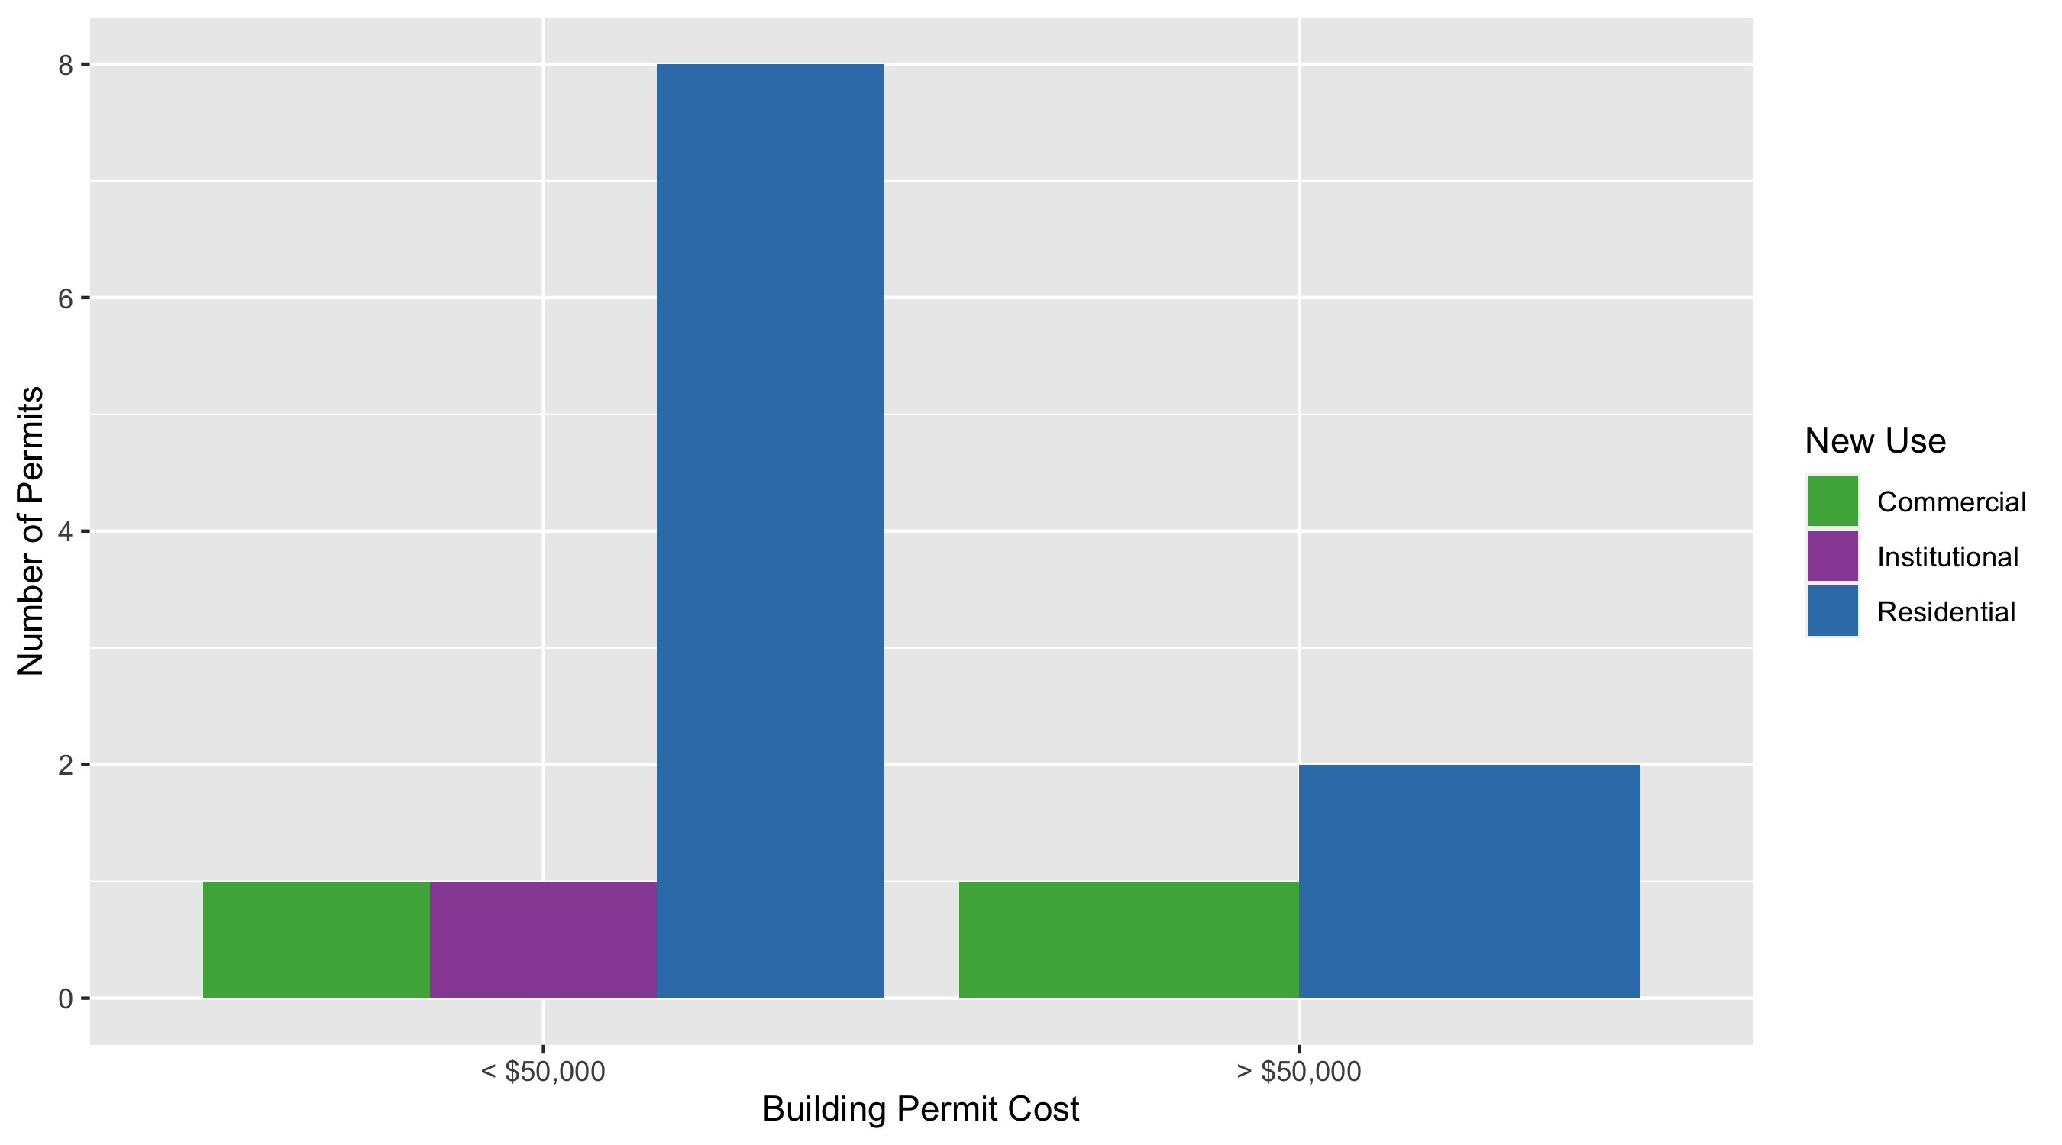
Skinker DeBaliviere Permit Cost Breakdown

Slide 27
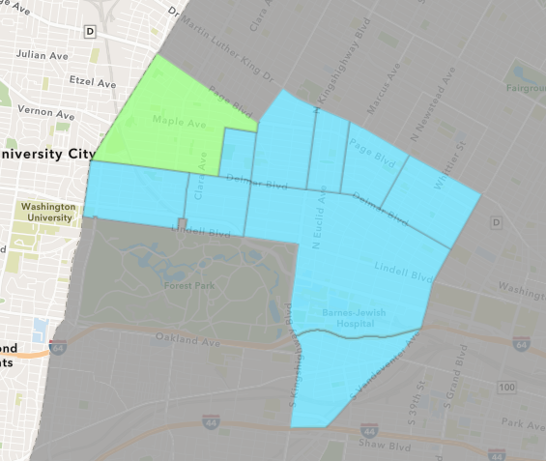
West End
September 2020 Neighborhood Cost Breakdown
Mean: $28,552
Median: $4,000
Range: $666 - $190,000

Slide 28
West End: Summary Notes
9 building permits in September 2020
50.00% change compared to September 2019 (6 total building permits)
$28,552: Average building permit cost in September 2020
282.40% change compared to September 2019 ($7,467)
59 total building permits in 2020
55.26% change YTD compared to this time in 2019 (38 total building permits)
$400,613: YTD average building permit cost in 2020
203.90% change YTD compared to this time in 2019 ($131,825)

Slide 29
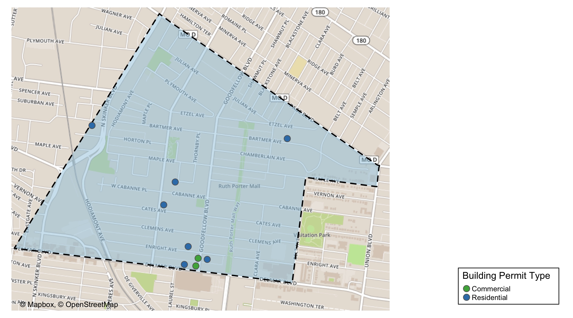
West End

Slide 30
West End
September 2020 | September 2020 | September 2020 | September 2020
Permit Use | Average Cost | # of Permits | Total Value of Permits
Commercial | $666 | 2 | $1,332
Industrial | $0 | 0 | $0
Institutional | $0 | 0 | $0
Residential | $36,520 | 7 | $255,640
Last 6 Months | Last 6 Months | Last 6 Months | Last 6 Months
Permit Use | Average Cost | # of Permits | Total Value of Permits
Commercial | $6,333 | 4 | $25,332
Industrial | $0 | 0 | $0
Institutional | $3,509,345 | 3 | $10,528,035
Residential | $428,857 | 28 | $12,007,990

Slide 31
West End Individual Permit Breakdown
Owner | New Use | Cost | Address
WILSON, FRANK | Residential | $666 | 5864 ENRIGHT AV
HASIC, MUHAMED & HEBA A MOUSSA | Commercial | $666 | 5874 ENRIGHT AV
MORGAN, ROBERT & KAREN | Commercial | $666 | 5880 ENRIGHT AV
STL ONE LLC | Residential | $10,000 | 1135 HODIAMONT AV
WEST END LLC | Residential | $190,000 | 5856 CLEMENS AV
WILSON, FRANK | Residential | $40,000 | 5709 ENRIGHT AV
HAWKERSELF, DARLENE & KATHERINE | Residential | $4,000 | 933 MARYVILLE AV
STEARNS, THERESA M | Residential | $7,000 | 5571 BARTMER AV
GIBSON, KARLA | Residential | $3,974 | 5895 CATES AV

Slide 32
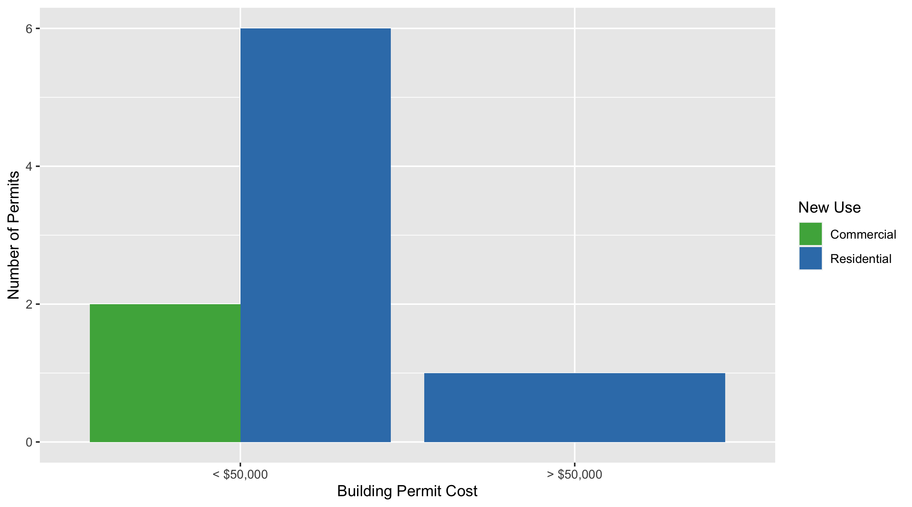
West End Permit Cost Breakdown

Slide 33
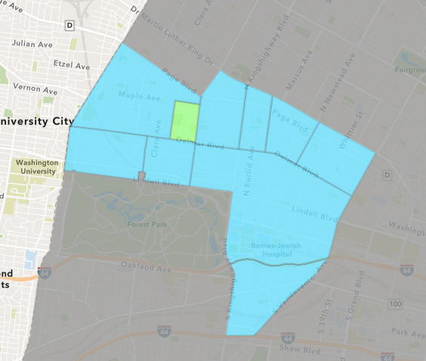
Visitation Park
September 2020 Neighborhood Cost Breakdown
Mean: $6,400
Median: $6,400
Range: $6,400 - $6,400

Slide 34
Visitation Park: Summary Notes
1 building permits in September 2020
Infinite change compared to September 2019 (0 total building permits)
$6,400: Average building permit cost in September 2020
Infinite change compared to September 2019 ($0)
6 total building permits in 2020
500.00% change YTD compared to this time in 2019 (1 total building permits)
$18,242: YTD average building permit cost in 2020
128.03% change YTD compared to this time in 2019 ($8,000)

Slide 35
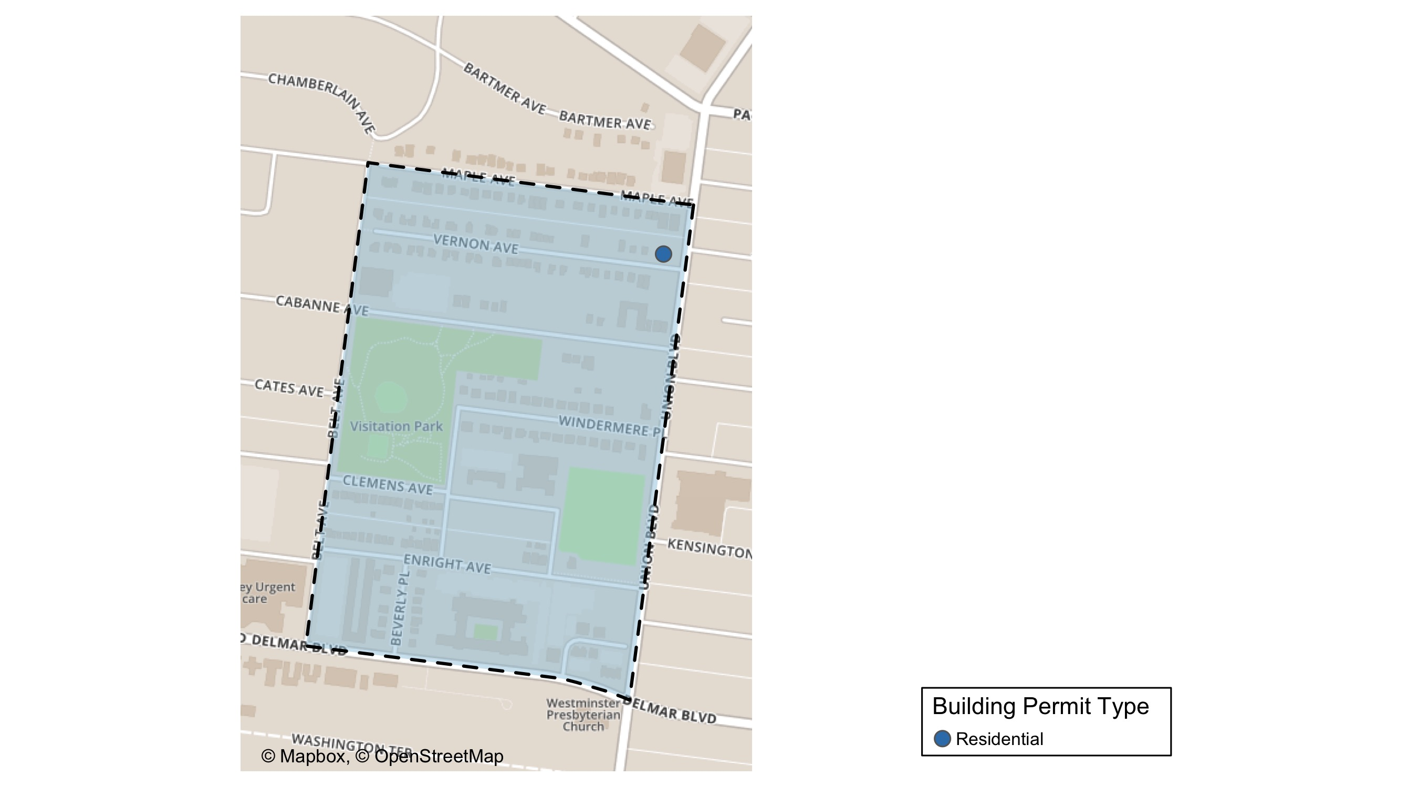
Visitation Park

Slide 36
Visitation Park
September 2020 | September 2020 | September 2020 | September 2020
Permit Use | Average Cost | # of Permits | Total Value of Permits
Commercial | $0 | 0 | $0
Industrial | $0 | 0 | $0
Institutional | $0 | 0 | $0
Residential | $6,400 | 1 | $6,400
Last 6 Months | Last 6 Months | Last 6 Months | Last 6 Months
Permit Use | Average Cost | # of Permits | Total Value of Permits
Commercial | $0 | 0 | $0
Industrial | $0 | 0 | $0
Institutional | $0 | 0 | $0
Residential | $19,091 | 5 | $95,455

Slide 37
Visitation Park Individual Permit Breakdown
Owner | New Use | Cost | Address
WWREALESTATEINVEST LLC | Residential | $6,400 | 5300-5304 MAPLE AV

Slide 38
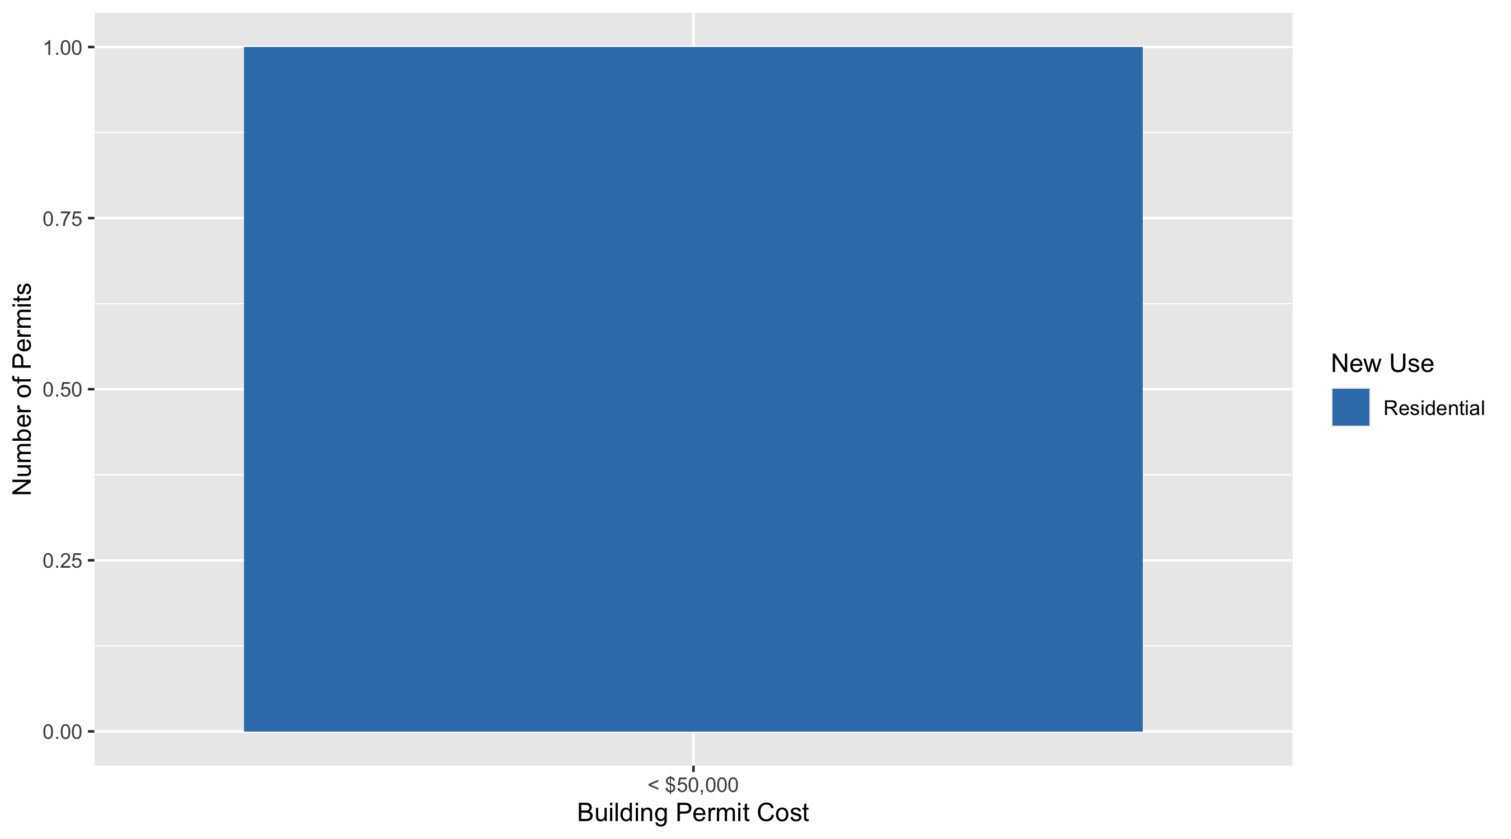
Visitation Park Permit Cost Breakdown

Slide 39
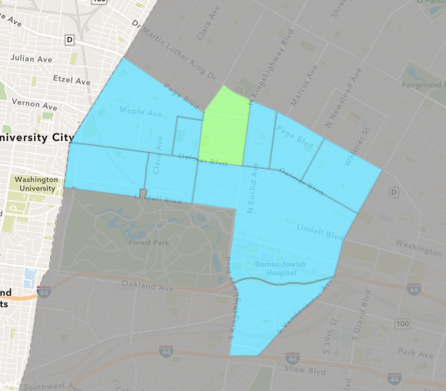
Academy
September 2020 Neighborhood Cost Breakdown
Mean: $21,868
Median: $13,635
Range: $200 - $60,000

Slide 40
Academy: Summary Notes
4 building permits in September 2020
-50.00% change compared to September 2019 (8 total building permits)
$21,868: Average building permit cost in September 2020
539.63% change compared to September 2019 ($3,419)
35 total building permits in 2020
16.67% change YTD compared to this time in 2019 (30 total building permits)
$44,792: YTD average building permit cost in 2020
-21.05% change YTD compared to this time in 2019 ($56,735)

Slide 41
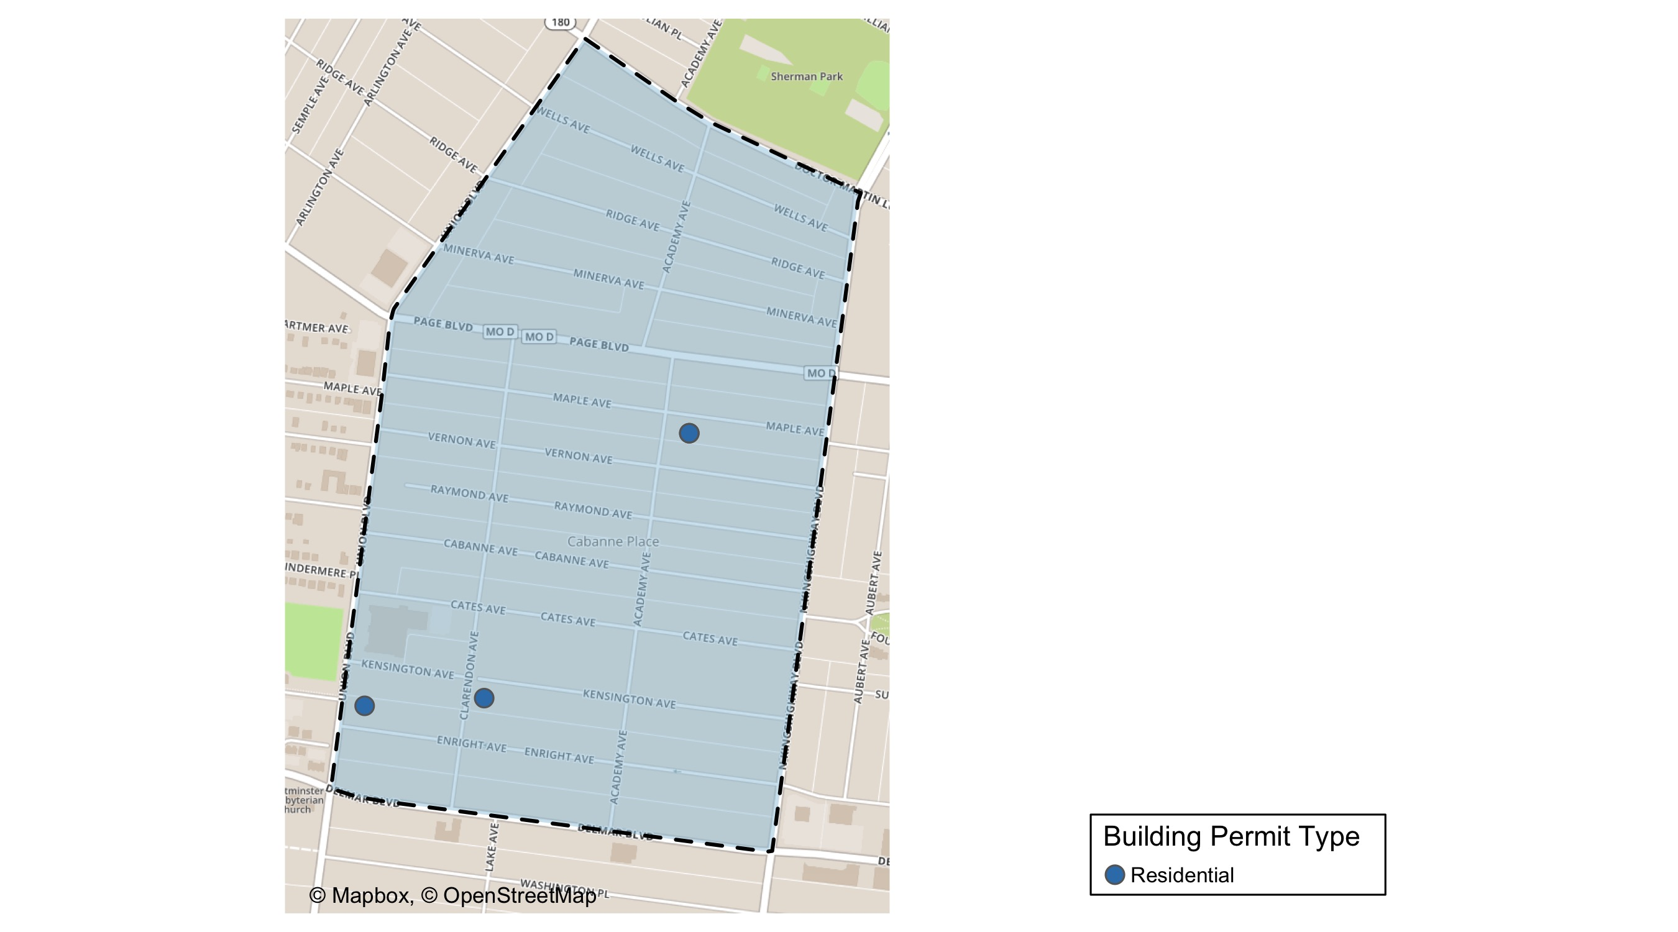
Academy

Slide 42
Academy
September 2020 | September 2020 | September 2020 | September 2020
Permit Use | Average Cost | # of Permits | Total Value of Permits
Commercial | $0 | 0 | $0
Industrial | $0 | 0 | $0
Institutional | $0 | 0 | $0
Residential | $21,868 | 4 | $87,470
Last 6 Months | Last 6 Months | Last 6 Months | Last 6 Months
Permit Use | Average Cost | # of Permits | Total Value of Permits
Commercial | $10,000 | 1 | $10,000
Industrial | $0 | 0 | $0
Institutional | $27,500 | 2 | $55,000
Residential | $28,535 | 22 | $627,770

Slide 43
Academy Individual Permit Breakdown
Owner | New Use | Cost | Address
WORTH THE WAIT LLC | Residential | $60,000 | 5039 RAYMOND AV
BATSELL, ERNEST | Residential | $7,000 | 5159 KENSINGTON AV
WORTH THE WAIT LLC | Residential | $200 | 5039 RAYMOND AV
SYMS, MELBA DEE JOHNSON | Residential | $20,270 | 5217 ENRIGHT AV

Slide 44
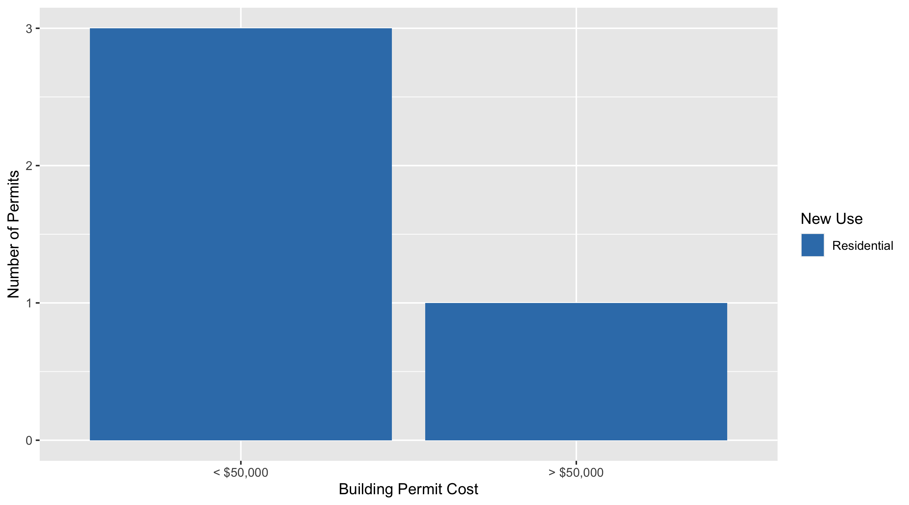
Academy Permit Cost Breakdown

Slide 45
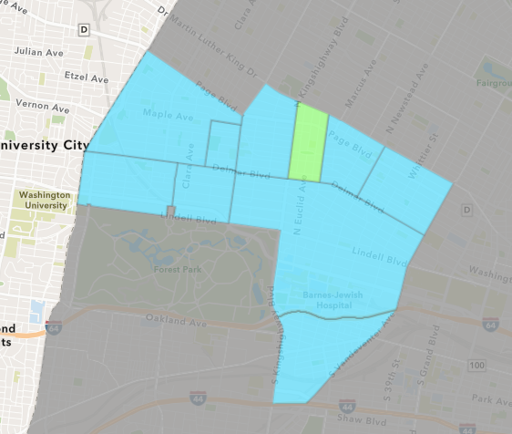
Fountain Park
September 2020 Neighborhood Cost Breakdown
Mean: $175,000
Median: $175,000
Range: $175,000 - $175,000

Slide 46
Fountain Park: Summary Notes
1 building permits in September 2020
0.00% change compared to September 2019 (1 total building permits)
$175,000: Average building permit cost in September 2020
600.00% change compared to September 2019 ($25,000)
8 total building permits in 2020
0.00% change YTD compared to this time in 2019 (8 total building permits)
$72,938: YTD average building permit cost in 2020
122.57% change YTD compared to this time in 2019 ($32,771)

Slide 47
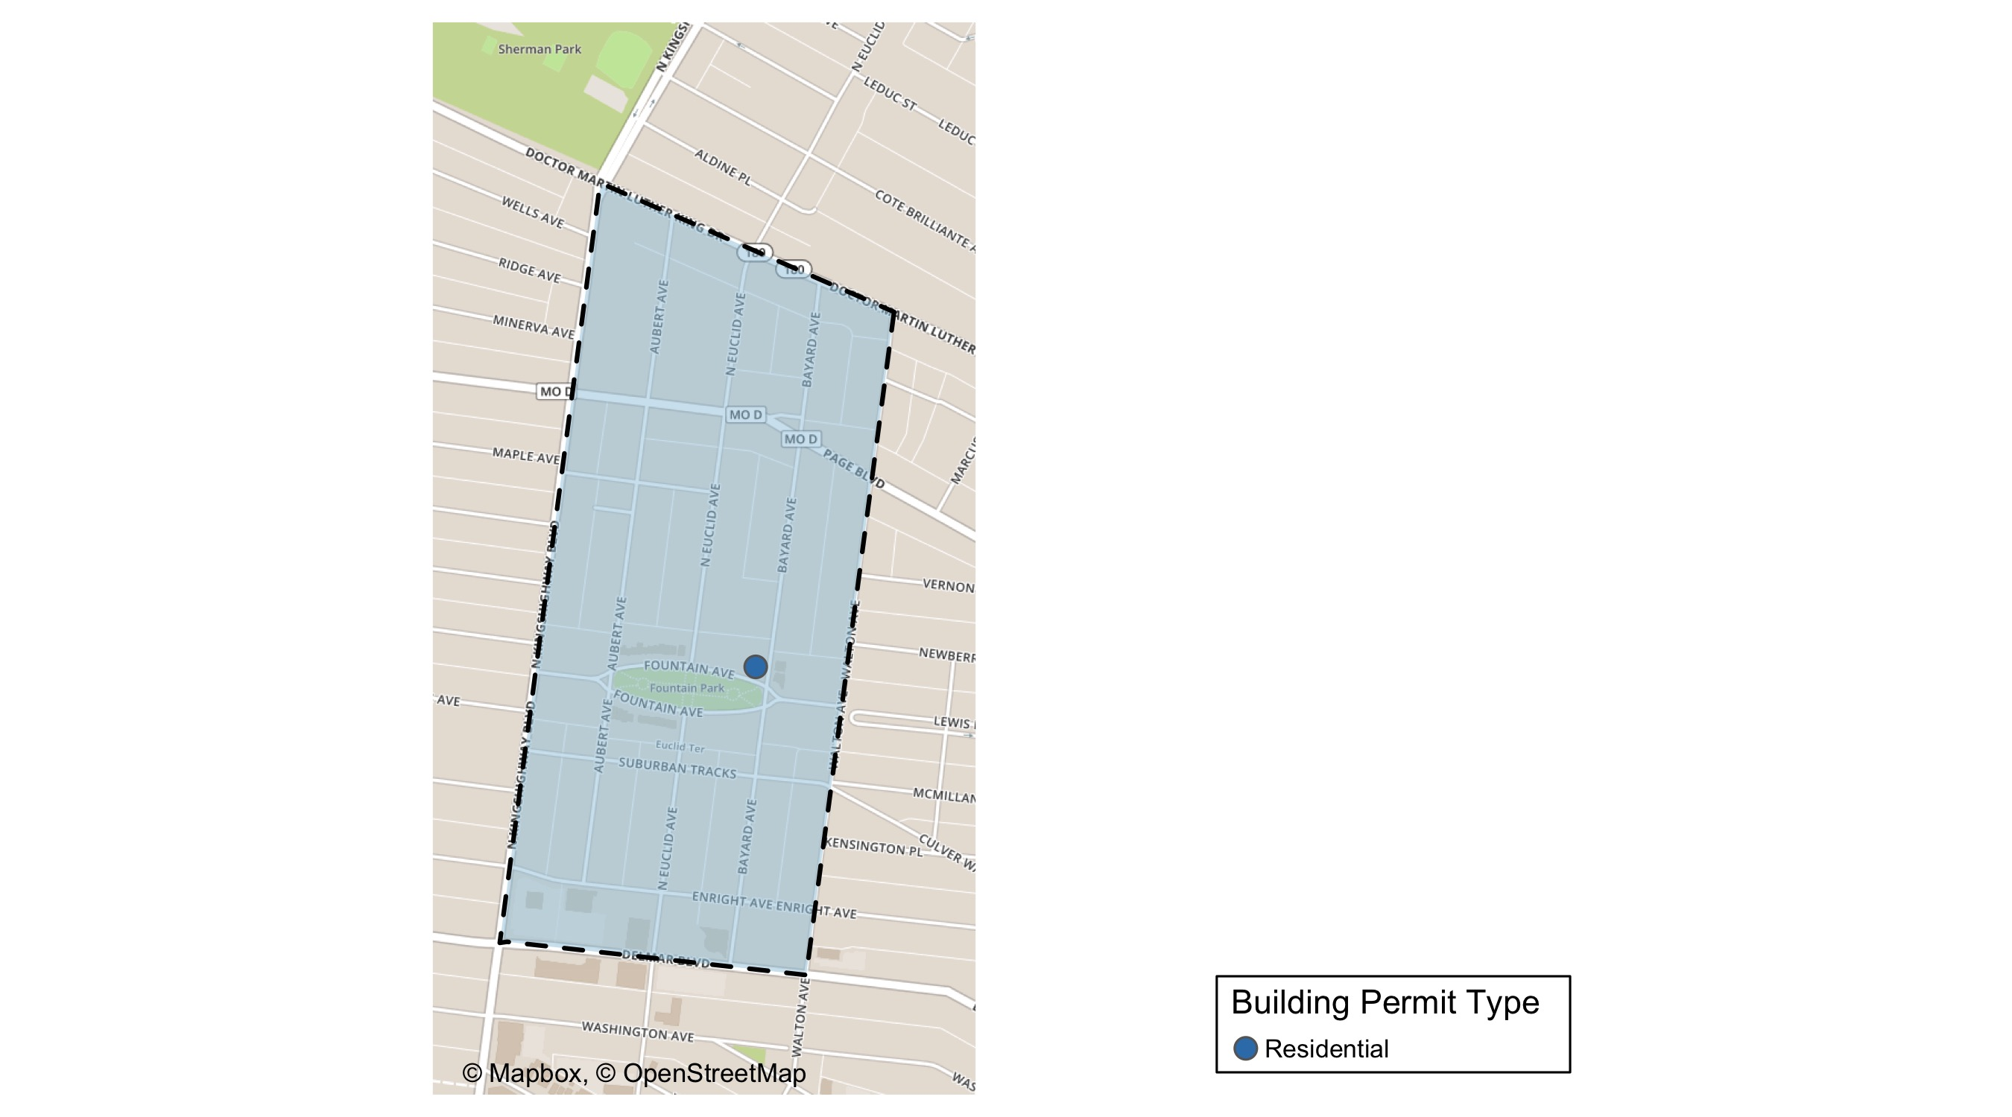
Fountain Park

Slide 48
Fountain Park
September 2020 | September 2020 | September 2020 | September 2020
Permit Use | Average Cost | # of Permits | Total Value of Permits
Commercial | $0 | 0 | $0
Industrial | $0 | 0 | $0
Institutional | $0 | 0 | $0
Residential | $175,000 | 1 | $175,000
Last 6 Months | Last 6 Months | Last 6 Months | Last 6 Months
Permit Use | Average Cost | # of Permits | Total Value of Permits
Commercial | $0 | 0 | $0
Industrial | $0 | 0 | $0
Institutional | $0 | 0 | $0
Residential | $83,071 | 7 | $581,500

Slide 49
Fountain Park Individual Permit Breakdown
Owner | New Use | Cost | Address
KINGSWAY DEVELOPMENT LLC | Residential | $175,000 | 4845 FOUNTAIN AV

Slide 50

Fountain Park Permit Cost Breakdown

Slide 51
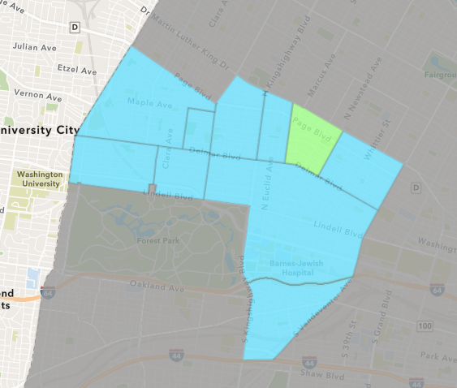
Lewis Place
September 2020 Neighborhood Cost Breakdown
Mean: $44,875
Median: $8,000
Range: $3,500 - $160,000

Slide 52
Lewis Place: Summary Notes
4 building permits in September 2020
300.00% change compared to September 2019 (1 total building permits)
$44,875: Average building permit cost in September 2020
199.17% change compared to September 2019 ($15,000)
14 total building permits in 2020
100.00% change YTD compared to this time in 2019 (7 total building permits)
$56,533: YTD average building permit cost in 2020
605.40% change YTD compared to this time in 2019 ($8,014)

Slide 53
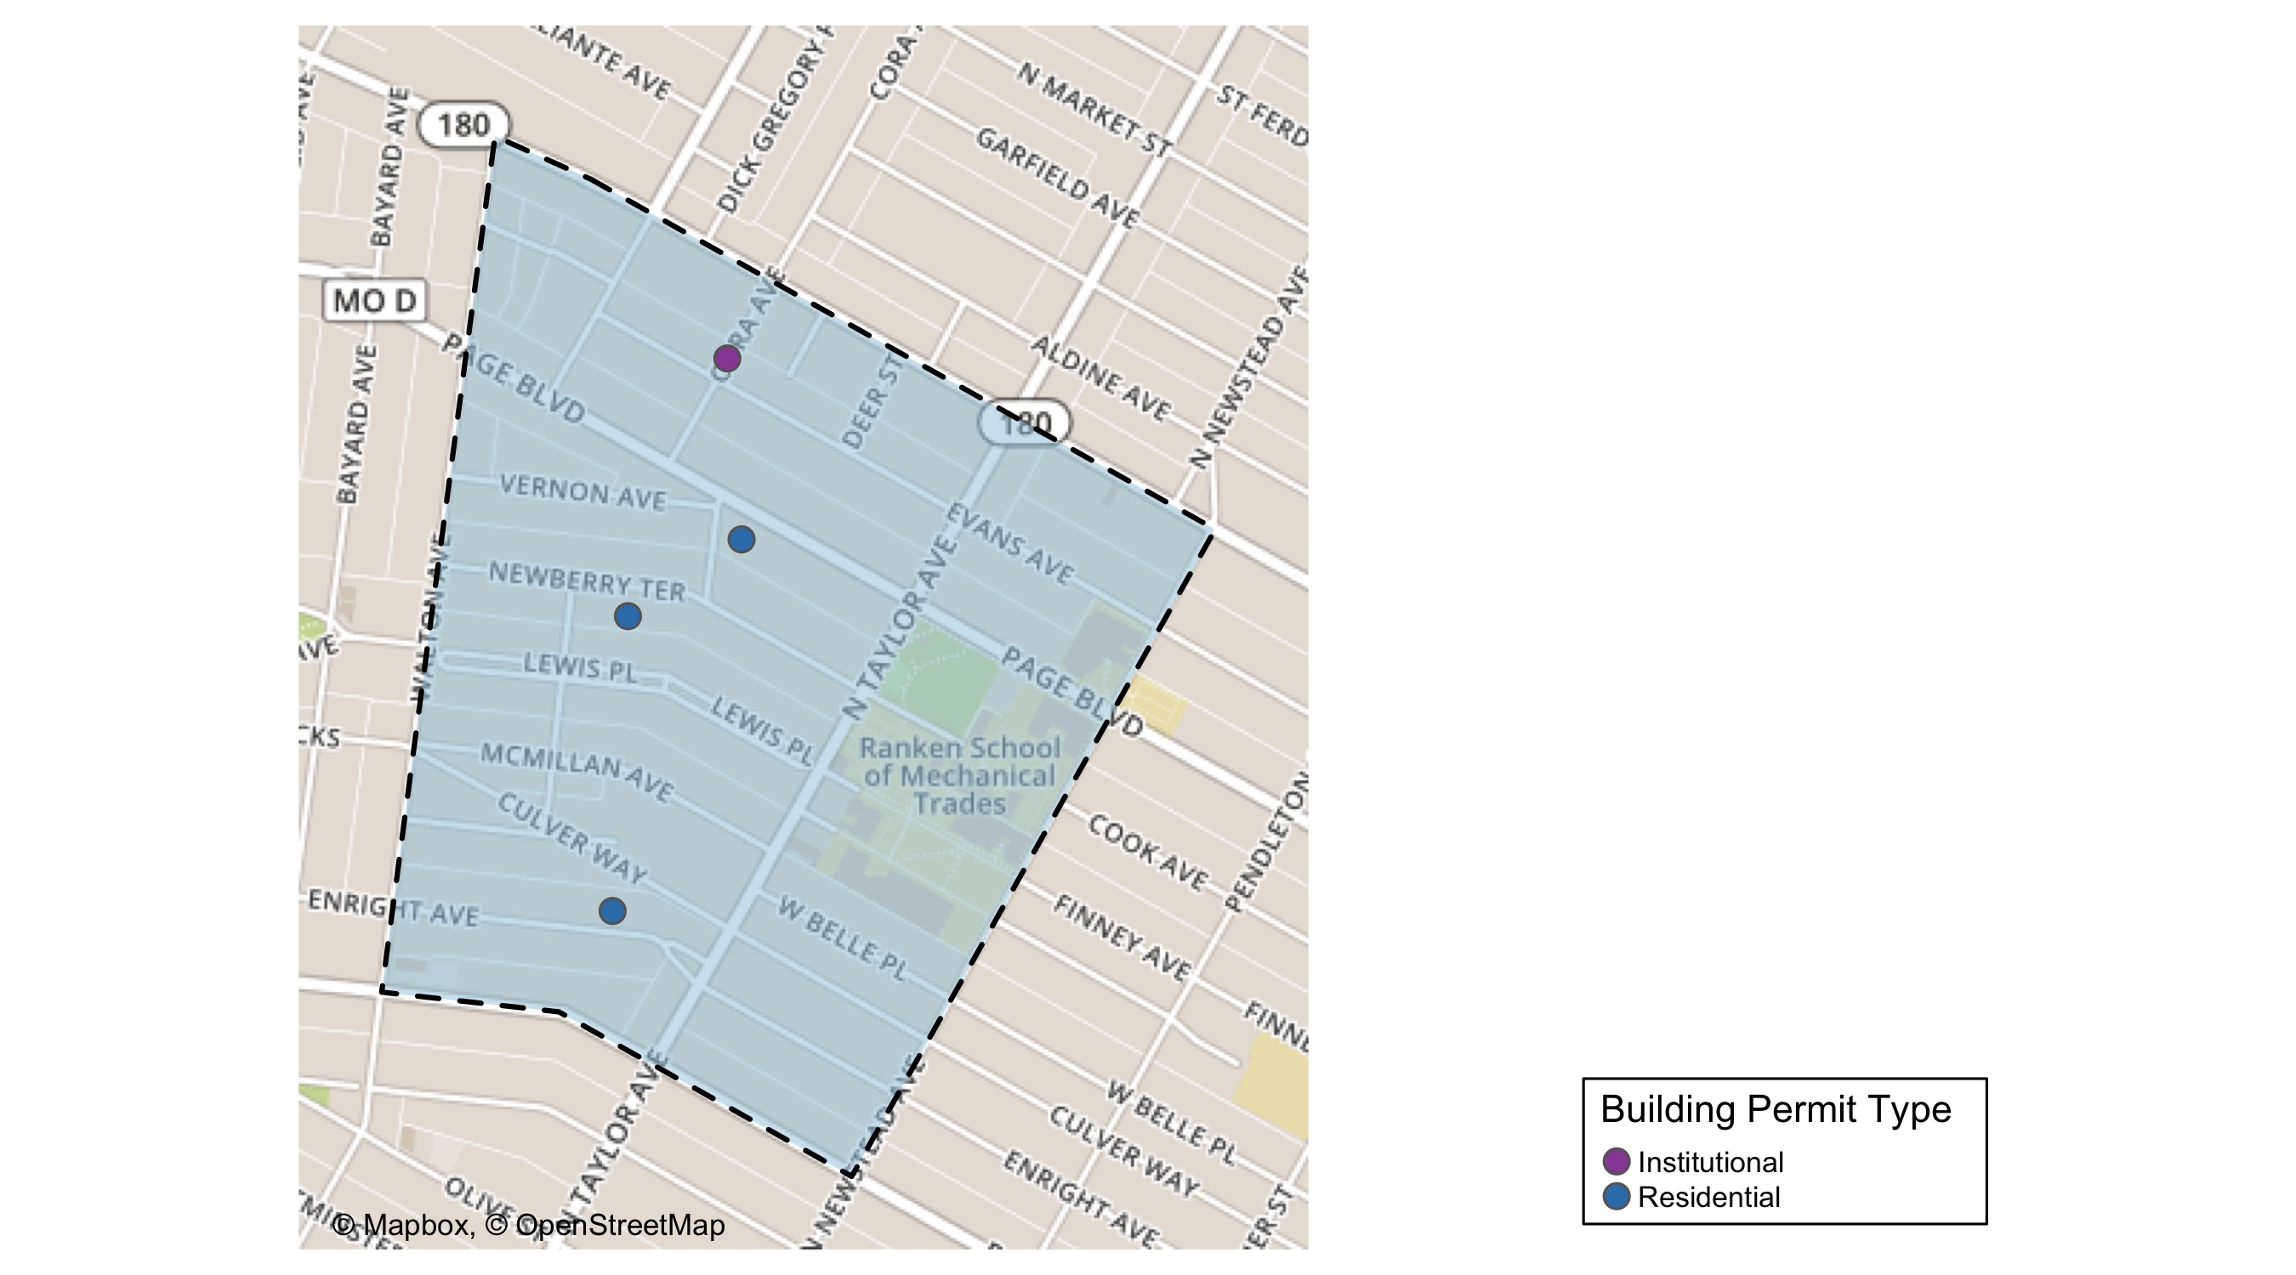
Lewis Place

Slide 54
Lewis Place
September 2020 | September 2020 | September 2020 | September 2020
Permit Use | Average Cost | # of Permits | Total Value of Permits
Commercial | $0 | 0 | $0
Industrial | $0 | 0 | $0
Institutional | $10,000 | 1 | $10,000
Residential | $56,500 | 3 | $169,500
Last 6 Months | Last 6 Months | Last 6 Months | Last 6 Months
Permit Use | Average Cost | # of Permits | Total Value of Permits
Commercial | $108,800 | 4 | $435,200
Industrial | $0 | 0 | $0
Institutional | $10,000 | 1 | $10,000
Residential | $42,970 | 8 | $343,760

Slide 55
Lewis Place Individual Permit Breakdown
Owner | New Use | Cost | Address
WALKER, LARRY | Residential | $3,500 | 4541 ENRIGHT AV
JONES, ROSIE ANN & DERRIN JONES | Residential | $6,000 | 4563 NEWBERRY TER
HICKS, TIFFANY ELAINE | Residential | $160,000 | 4704 NEWBERRY TER
WILSON, HAROLD | Institutional | $10,000 | 1423-29 CORA AV

Slide 56
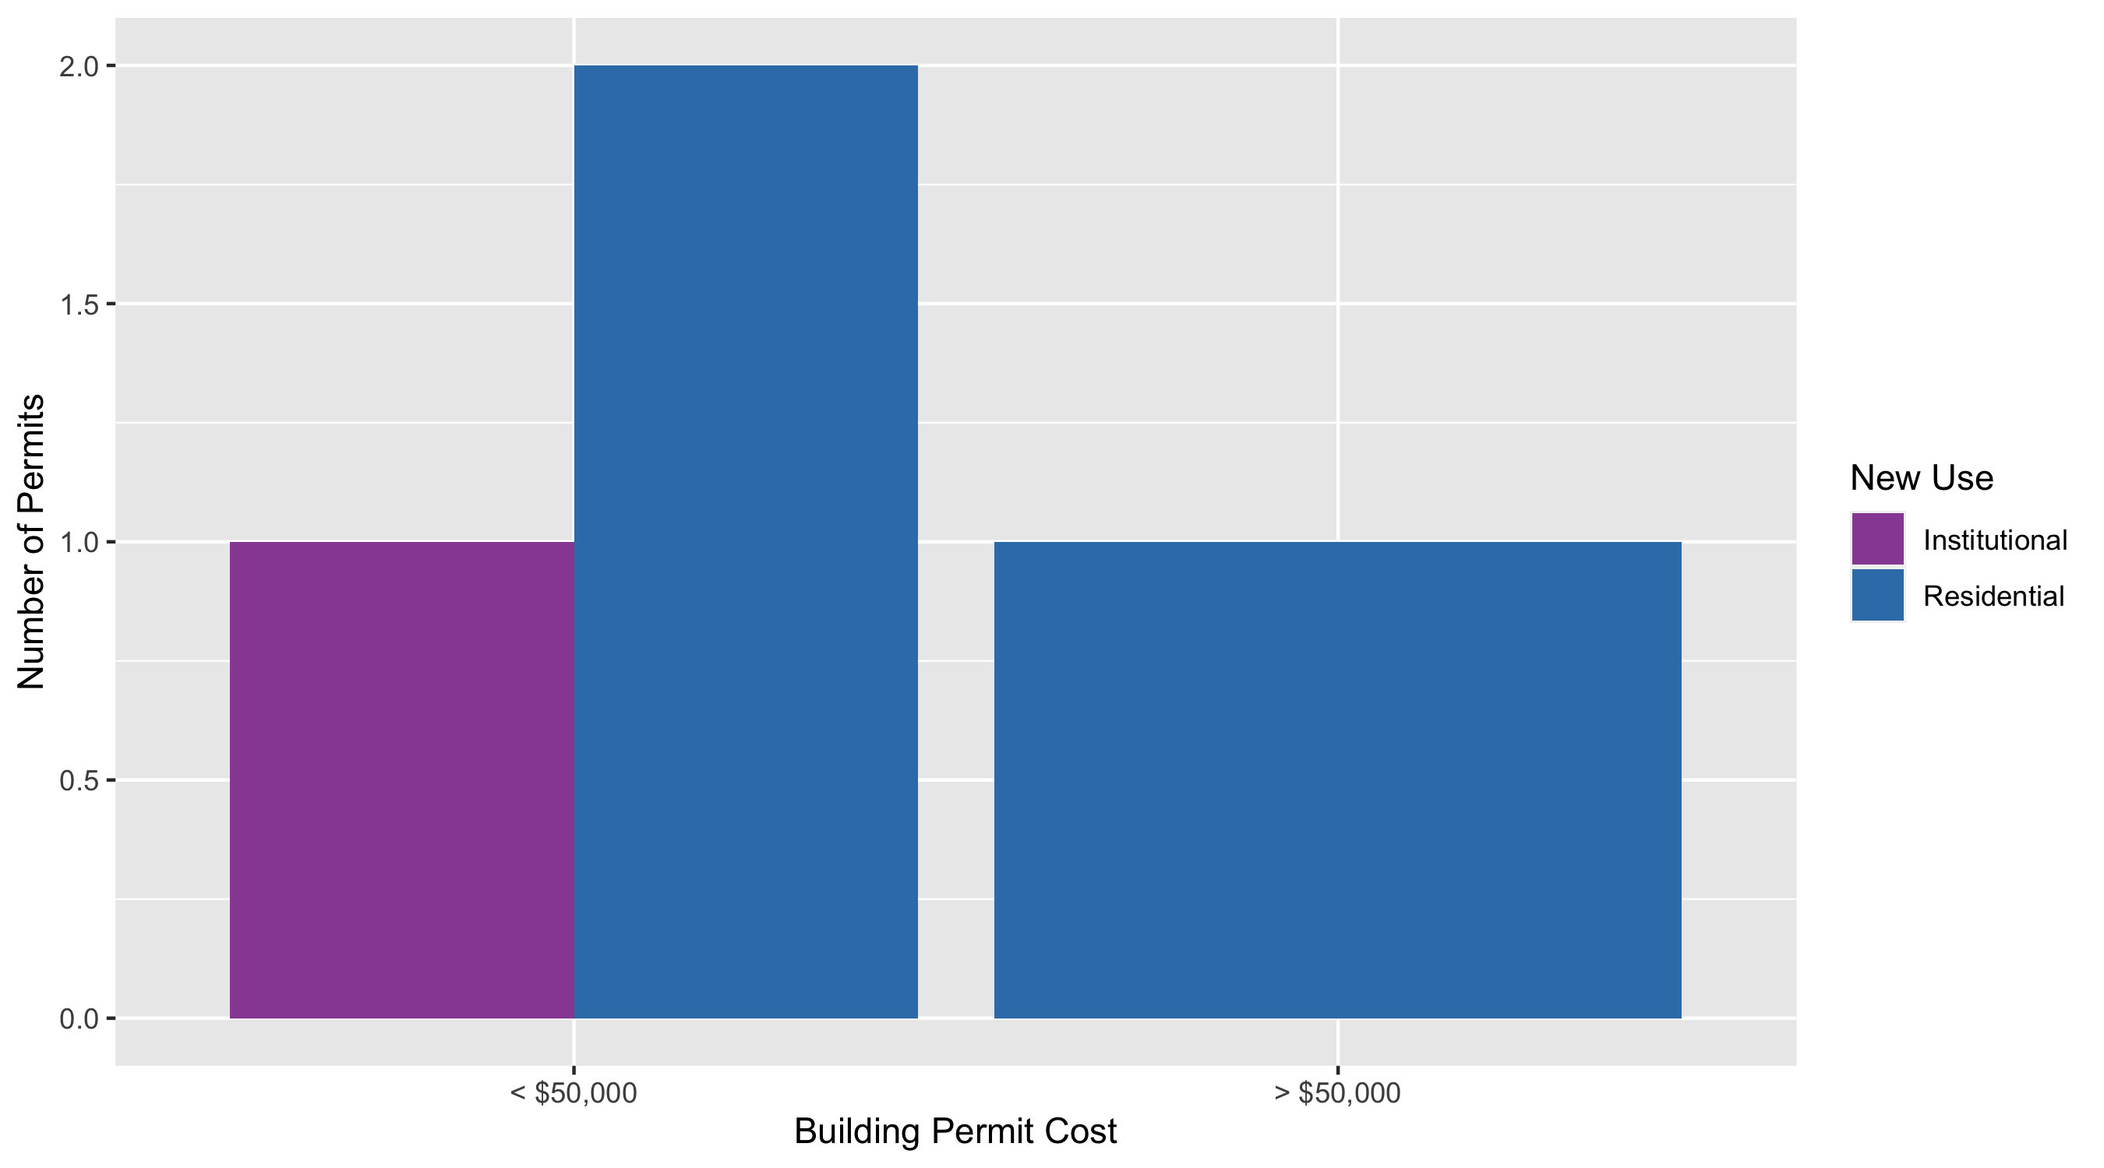
Lewis Place Permit Cost Breakdown

Slide 57
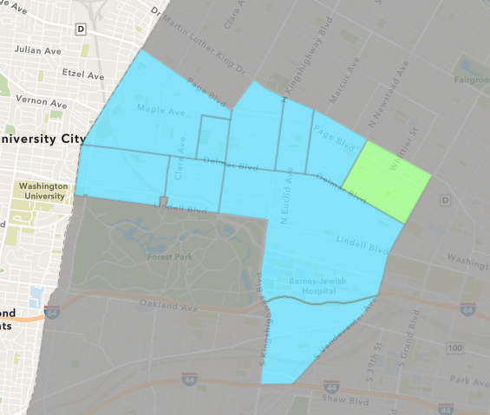
Vandeventer
September 2020 Neighborhood Cost Breakdown
Mean: $9,324
Median: $9,324
Range: $5,649 - $13,000

Slide 58
Vandeventer: Summary Notes
2 building permits in September 2020
-60.00% change compared to September 2019 (5 total building permits)
$9,324: Average building permit cost in September 2020
-77.75% change compared to September 2019 ($41,900)
11 total building permits in 2020
-63.33% change YTD compared to this time in 2019 (30 total building permits)
$49,884: YTD average building permit cost in 2020
-57.95% change YTD compared to this time in 2019 ($118,618)

Slide 59
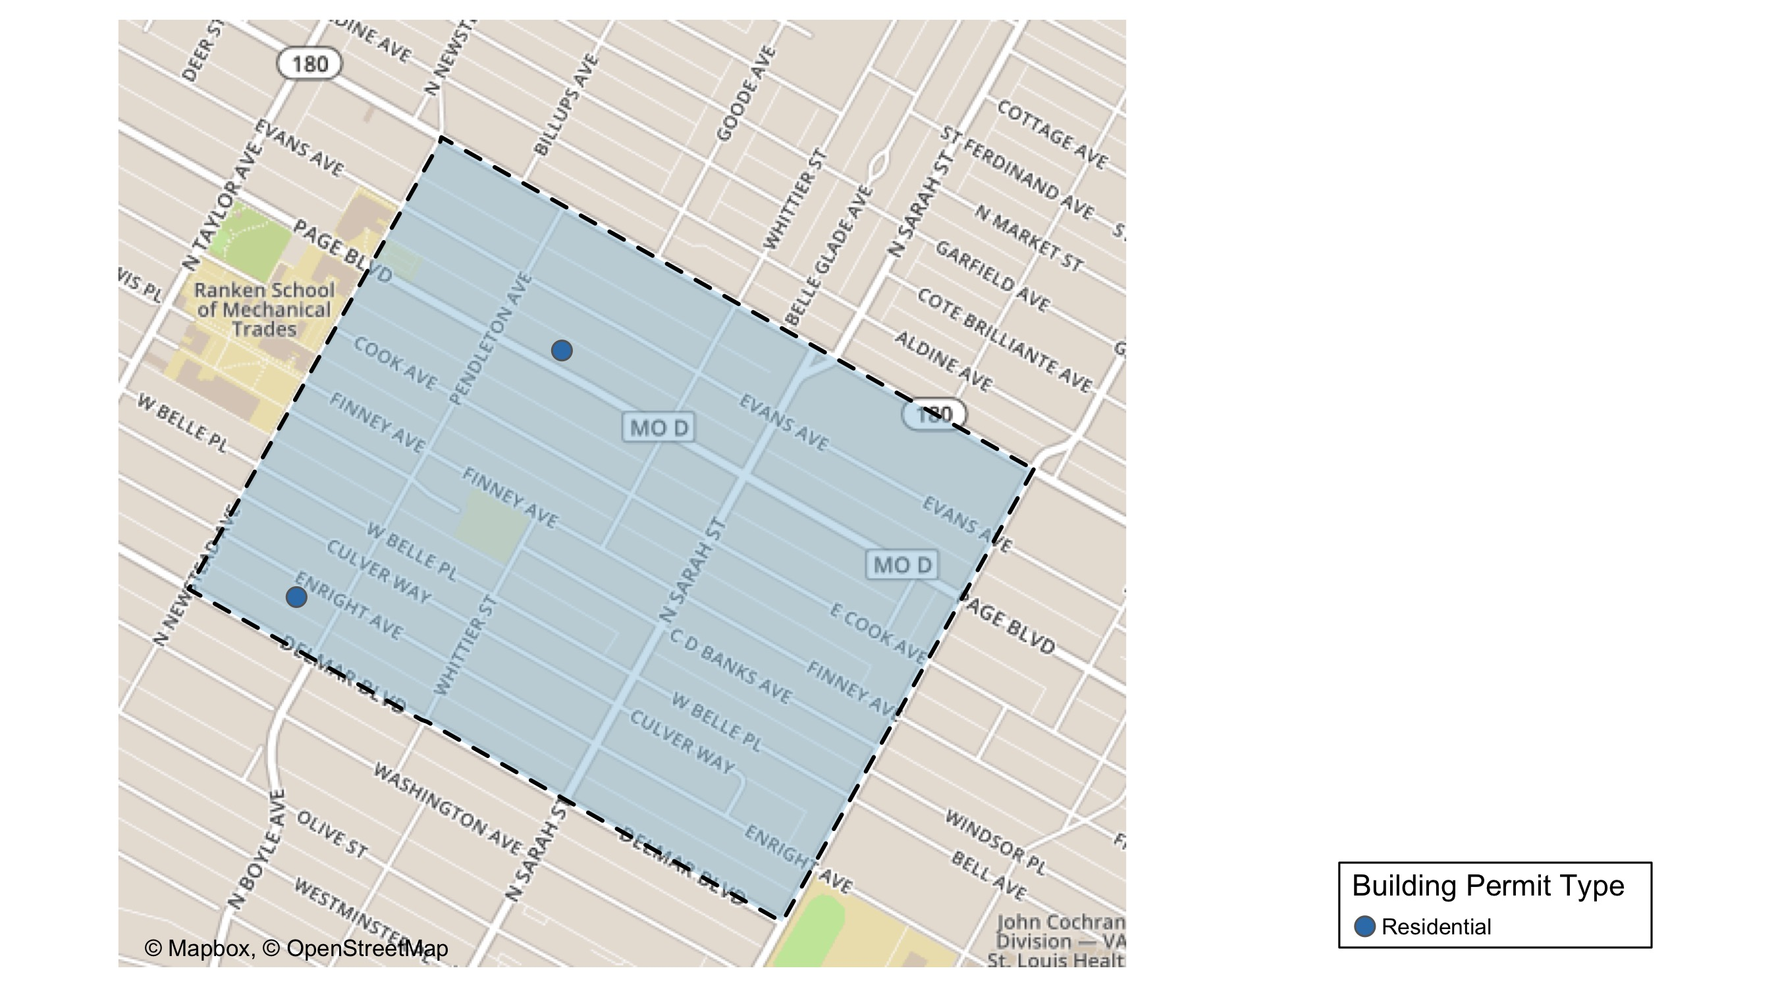
Vandeventer

Slide 60
Vandeventer
September 2020 | September 2020 | September 2020 | September 2020
Permit Use | Average Cost | # of Permits | Total Value of Permits
Commercial | $0 | 0 | $0
Industrial | $0 | 0 | $0
Institutional | $0 | 0 | $0
Residential | $9,324 | 2 | $18,649
Last 6 Months | Last 6 Months | Last 6 Months | Last 6 Months
Permit Use | Average Cost | # of Permits | Total Value of Permits
Commercial | $0 | 0 | $0
Industrial | $0 | 0 | $0
Institutional | $500 | 1 | $500
Residential | $51,808 | 6 | $310,849

Slide 61
Vandeventer Individual Permit Breakdown
Owner | New Use | Cost | Address
BUSIEK, MIRCALA D & ALAN G | Residential | $5,649 | 4357 ENRIGHT AV
LOS LLC | Residential | $13,000 | 4223 W PAGE BLVD

Slide 62
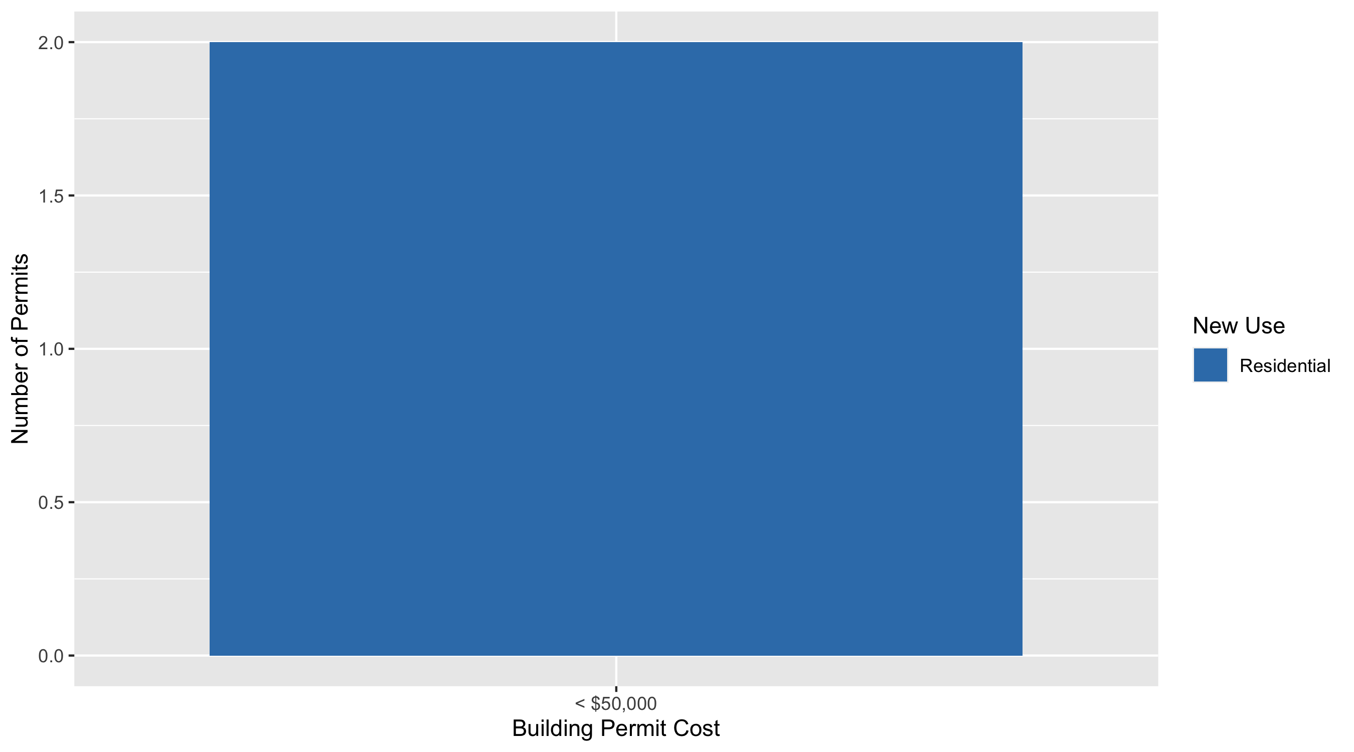
Vandeventer Permit Cost Breakdown

Slide 63
Additional Notes
Data retreived from https://www.stlouis-mo.gov/data/
Building permits with a cost of $0 were dropped
Building permits that were cancelled were dropped
Infinite change indicates 0 permits in the current or previous time period/comparison month so there was a overall increase or decrease

